Slide 1
Inter-secterol co-operation and (mental) healthcare
Joyce Kenkre
Professor of Primary Care

Slide 2
Social Prescribing
Social prescribing has become an umbrella term to describe ways of linking individuals to sources of community-based, non-medical support. There is no fixed definition of social prescribing, however, it is generally considered as a mechanism that acts to systematically link people to wellbeing services

Slide 3
Adverse childhood experiences
Those people who had more than 4 ACE were:
4 x more likely to be a high risk drinker
6 x more likely to have or caused unintended teenage pregnancy
6x more likely to smoke
6 x more likely to have had sex under 16
11 x more likely to have smoked cannabis
14 x more likely to have been a victim of violence in the last 12 mths
15 x more likely to have committed violence against another person
16 x more likely to have used crack cocaine or heroin
20 x more likely to have been incarcerated at any point in their life

Slide 4
HomeStart MESH Data
Preliminary analysis on 18 months of data collection [April 2011 – October 2012 all UK schemes]
Information on 33,925 families resident in the UK
76,031 children
40,870 males; 35,161 females
Supported by 15,000 volunteers

Slide 5
Family Circumstances on Referral
11,644 (34%) Living alone: 379 fathers
8668 (26%) Mental Health
5053 (15%) Postnatal depression
4391 (13%) Domestic abuse
1702 (5%) Learning disabilities
1390 (4%) Substance abuse
1146 (3%) Teenage pregnancy
365 (1%) Interpreter needed
Notes:
The health visitor was in all cases the health care professional that referred the most in all categories followed by the social worker

Slide 6
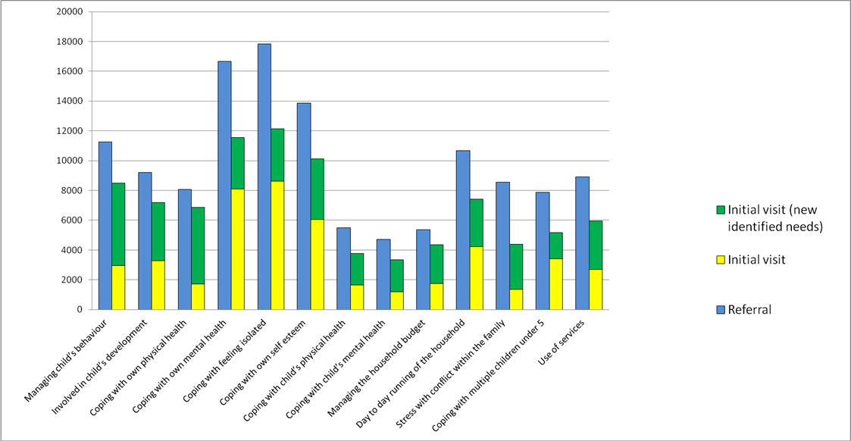

Slide 7
Needs at initial visit
Domain | Need | Total Number of Needs at Initial visit
Parenting skills | Managing child’s behaviour | 8494 (25%)
 | Involved in child’s development | 7176
Parenting well being | Coping with own physical health | 6868
 | Coping with own mental health | 11,554 (34%)
 | Coping with feeling isolated | 12,145 (36%)
 | Coping with own self esteem | 10,110 (30%)
Children’s well being | Coping with child’s physical health | 3784
 | Coping with child’s mental health | 3337
Family Management | Managing the household budget | 4370
 | Day to day running of the household | 1496
 | Stress with conflict within the family | 6187
 | Coping with multiple children under 5 | 5177
 | Use of services | 5949

Slide 8
Needs of those in a domestic abuse situation
Coping with feeling isolated 64%
Coping with own self esteem 58%
Coping with own mental health 58%
Stress through conflict within 54%
the family
Managing child’s behaviour 52%
Involved in child development 51%

Slide 9
Needs for domestic abuse versus those not known to be at risk at referral
Stress through conflict in the family ↑32%
Coping with self esteem ↑ 19%
Coping with feeling isolated ↑ 12%
Managing the household budget ↑12%

Slide 10
20 Domestic abuse volunteer diaries
1st visits - activities with the children
- emotional support
5th Visit - enabling access i.e job centre, toy library, toddler groups, housing advice, dentist
Greatest Journey of Change –
Feeling of isolation, managing child’s behaviour, feeling of self esteem

Slide 11
“Our Place” - Group for young mothers and their children who were socially isolated and lacked confidence
For young parents to get together to make new friends, build their confidence and develop their parenting, life and home making skills
A friendly welcome
Support with little ones from qualified and experienced childcare
A safe, non-judgemental environment
Hints and tips on parenting
Sign posting onto other services

Slide 12
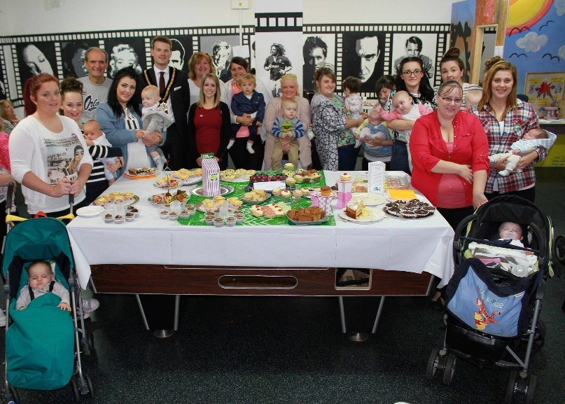
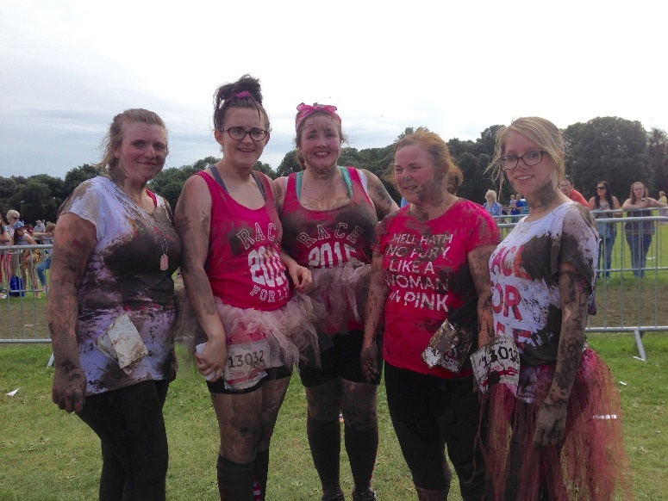
“Our Place” young parents enjoy taking part in outside events:
Teddy Bear Picnic
Soft Play
Charity Mud Run/cake bake
Celebrating Anniversaries

Slide 13
Life choices
Found out how to cook healthy food from scratch
Budgeting better and planning weekly shop
We eat healthier for our diet and teeth
Contacted housing to live nearer family
Feel able to make decisions enrolling child into welsh nursery to receive bilingual education

Slide 14
“Our Place”
Comments on parent-child relationship:
We talk all the time
We dance, we sing and make more time for bedtime stories, cook together, clean up toys, go to the park
We love singing and dancing together
We talk all the time explaining what things are in the supermarket, on the bus, out for a walk and in the bath

Slide 15
Comments from a magistrate
Courts is adversarial
Huge step to go into a court room and declare publically what has happened
Measures for victim support
Victim who has been a subject of emotional abuse – hard to testify
Reluctance of victim to co-operate with police and judicial
7-9 times police called and incident documented and victim refuses to testify Crown Prosecution Service will continue to prosecute
Greater appearance of shame in men when testifying what has happened to them in front of family and friends

