Slide 1
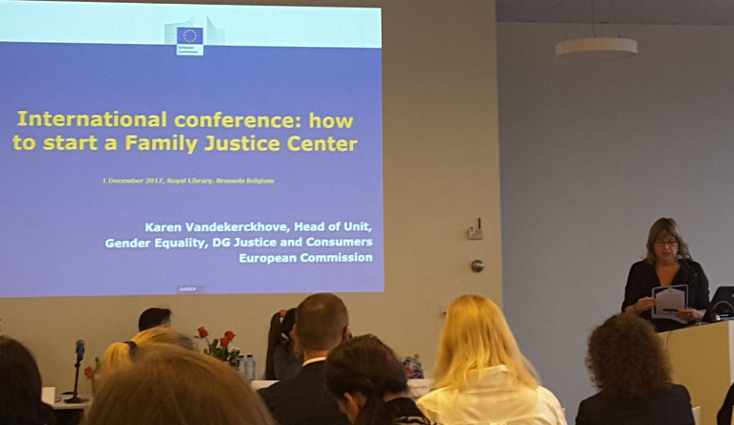

Slide 2
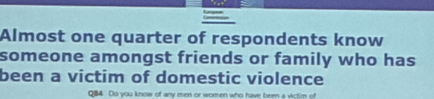
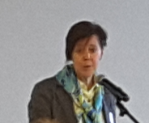
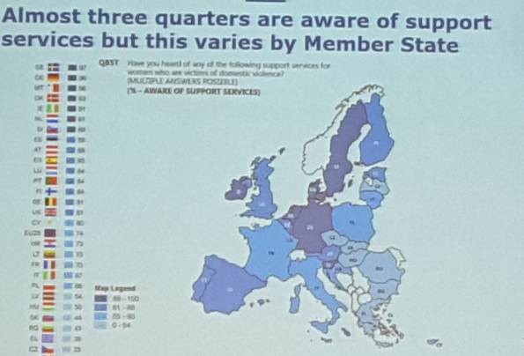
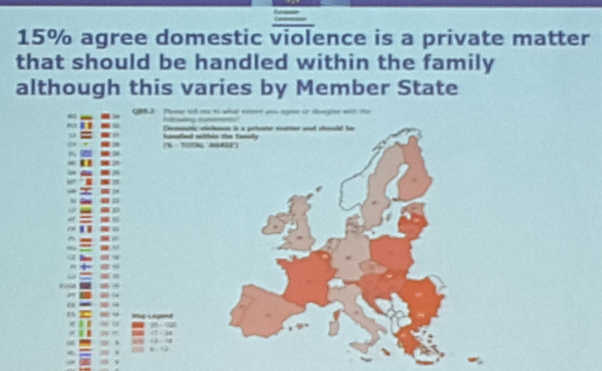

Slide 3
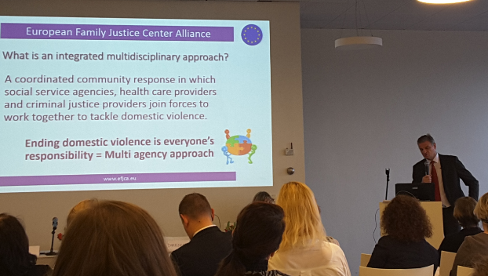
What is a FC ?

Slide 4
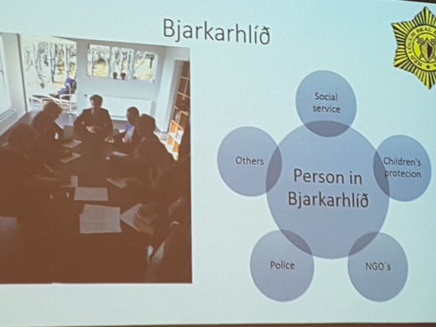
ONE SAFE PLACE
HOPE AND EMPOWERMENT

Slide 5
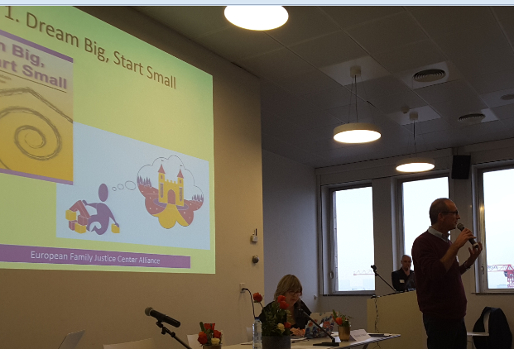
Starting FJC

Slide 6
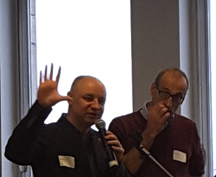
How to start a FC
Good ground and goals
Structure
Care for outside and inside
Its about cooperation
  Client focussed
  Integrity
  Safety first
  Transparency
Communication
….

Slide 7
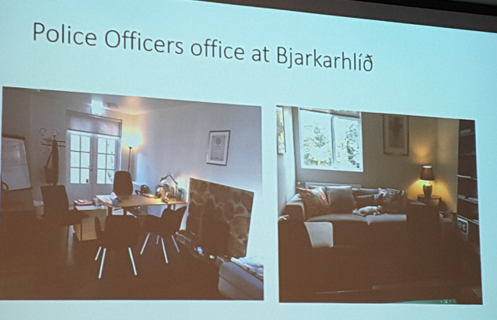
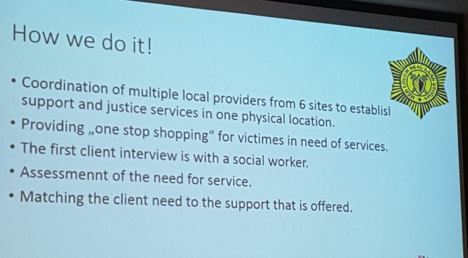
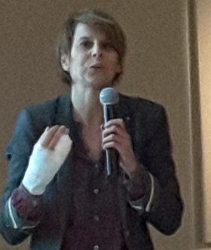
57% of perpetrators prior other offenses
Police keeps perpetrator accountable
Donot copy paste
Link to current facilities

Slide 8
About victims and perpetrators
Victim oriented versus family oriented?
Mind not to be sucked into one perspective
See parties first separately
Difference in riskassessment with parties
When a child is involved , must it get priority?
After violence stops , much more to do!
Perpetrator programme effects documented

Slide 9
Hope for children!
Children should only need to tell once
Child advocacy centers
Child friendly room
All specialists present

Slide 10

10 opportunities collaboration HC
Engage HC in positive collaboration !
Be aware of different case mix
Empower health care services
Create space for anonymous advice
Define a consensus based pathway including Health Care
Promote structural embedding of HC
Management
  Accessibility for HCP
  Tasks agreements should include Health Care
  Create adequate information channel
Agree sharing information in both directions
Make clear rules for confidentiality , but always communicate:
  Attendance after referral / non attendance
  Involved services and further referral
  Information essential for care
  Not only intake and release notes
Document short and long term effects

Slide 11
Ten suggestions to health care
Be aware of prevalence of FV and its many presentations
Listen to vague indirect signals
Focus discussion on violent events (after introduction)
Inquire about Ideas , concerns , needs & expectations
Consider context complaints (vulnerability,intersectionality)
Aim common understanding of thoughts, emotions and behaviors of the client system
Empower clients’ autonomy and coping
Audit practice task definitions, distribution and management
Discuss and agree carepathway with other sectors
Agree on what information to share in both directions
Notes:
CONCLUSIES : OP PRAKTIJK GERICHT

Slide 12
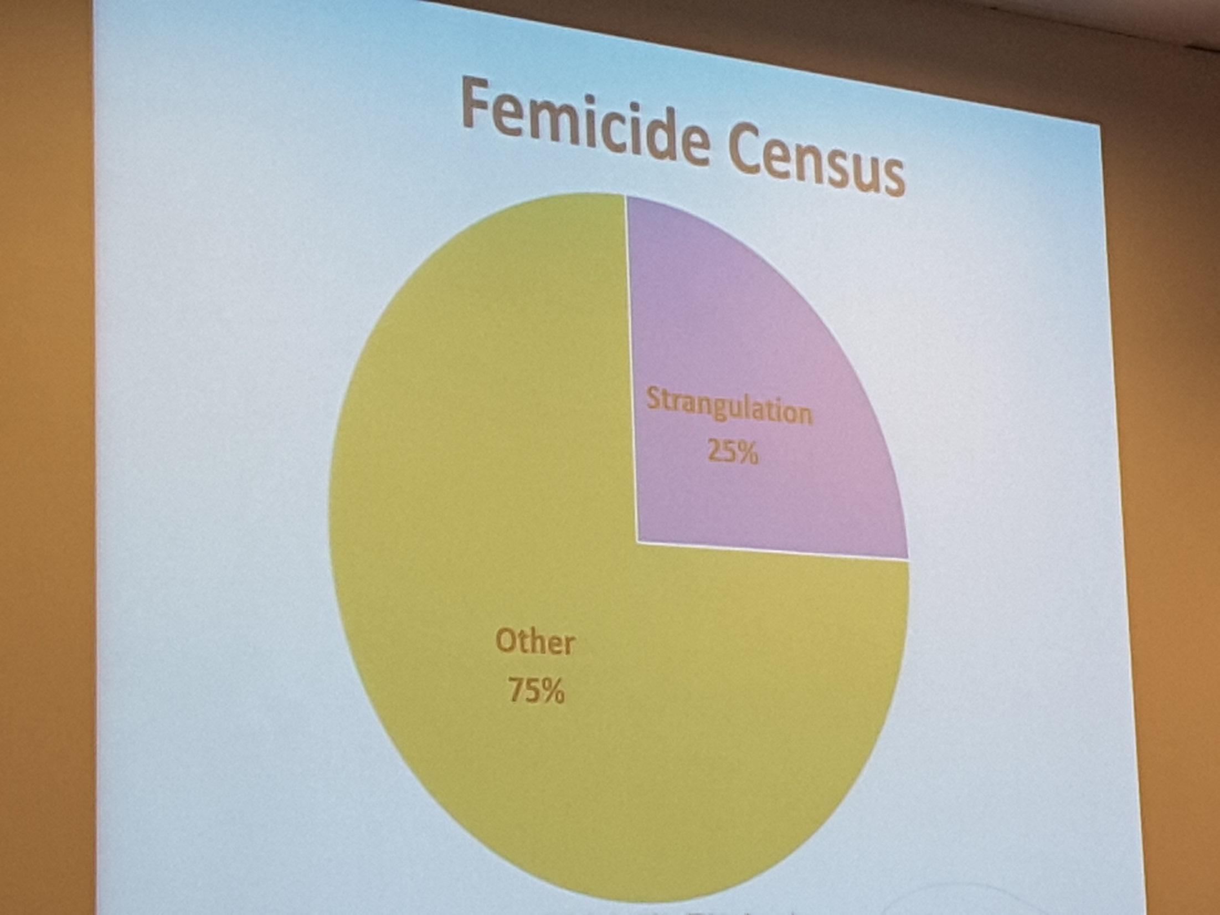
Perspective police and justice

Slide 13

Engaging health care into a multi-agency approach for domestic violence, child abuse and sexual violence
Bert Groen
Pascale Franck
Leo Pas

Slide 14

https://drive.google.com/file/d/1kvxGAVrk2iwrN22Q0vhenCwtf-tmUzLz/view?usp=sharing

Slide 15
Involving health care actively in a multisectorial care response to family violence, be it IPV, EA or CA, requires an integrated protocol for risk assessment, sharing information and consensus care pathway

Slide 16
A multisectorial management protocol should contain always
  Immediate management protocol for health care
    According specific professions
    Relationships within health care sector
    Safety management procedures
      For mayor & life threatening situations
      For lesser risk situations
    Documenting procedures
  MD carepathway for complex cases & high risk
  Follow-up procedures defining mutual HC & other sectors tasks and communciation principles
  For sharing information
    Within DIFFERENT CARE SECTORS : HEALTH/SOCIAL/MENTAL
    With PROTECTION AND LAW ENFORCEMENT

Slide 17
Attention to :
Context, vulnerability and multi-problem situations
alcohol
Minority
Social problems…
Mental
sufffering
victimisation or aggression

Slide 18
Presentions of family violence often are emotional , mental or behavioral consequences of family tensions and disputes, being it child abuse, elder abuse or intimate partner violence.
Health care sector needs to be taught to leave one problem focussed diagnostic reasoning

Slide 19
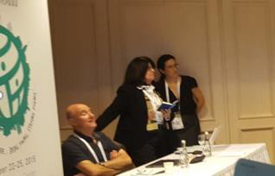
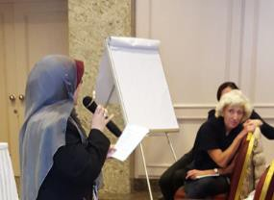
WONCA STATEMENT IDENTIFICATION
EUROPREV ISTANBUL 2015
Further studies are required to improve identification of FV in PHC in diverse settings
Such studies need to document outcomes as well as
potential harms;
The prevalence of IPV, the strong relationship with mental health and the prooven efficacy of mental health interventions require a casefinding strategy among those at higher risk , adapted to cultural contexts and local settings in particular among close relationships with mental health problems and during perinatal care

Slide 20

CHANGE FROM REACTIVE CARE TO PROACTIVE ORGANISATION OF CLIENT CENTERED APPROACH
Care providers
Client(s)
Practice
Empathy Idea?
Engage Concern?
Express Expectation?
Enhance Impact
Empower Autonomy
Ask
Assess
Advice &Agree
Assist
Arrange
Audit
Engage
Share
Rearrange
Manage

Slide 21
Stepped care communication principles proposed
Describe signals
Concert with carers in own setting
Consult advisory- or reportcenter
Discuss with client
Weigh risk violence
Decide how to assist
Securing safety
And/or report
Active Follow-up
Arrange protection
ASK
DISCUSS CONSULT
AGREE/ADVICE ASSESS
ASSIST: needs & safety
REPORT ASSURE FU
& SAFETY

Slide 22
BE AWARE OF DIFFERENT,
CASE MIX AND NUMBERS …
TOP OF ICEBERG : LAW
ENFORCEMENT
MIDDLE : SPECIALISED CARE
MENTAL CARE
BOTTOM : PRIMARY HEALTH
CARE & SOCIAL WELFARE

Slide 23

suggestion to collaborate between networks
Integrate learning pathways based on local protocols between health care and other professionals into a comprehensive care and protection strategy to train in a multidisciplinary context based on culturally relevant case mix learning from sharing experiences to collaborate in a system centered way

