Slide 1
10 opportunities to engage health care Leo Pas, MD

Slide 2
THOUGHTS
EMOTIONS
BEHAVIOR
EVENTS
& CON-
SEQUENCES
signal
BODILY
FEELINGS
1) ASK
2) ASSESS
Well fare &
Protection sector:
‘Ask & refer’
Does not work!
Health Care :
Leave medical
Diagnostic thinking
3) ASSIST
Acknowlegde,
Advice & Agree
4) ARRANGE
Safety &
Active follow Up

Slide 3
Health Care: pay more attention to context & vulnerability Donot focus on one medical issue!
alcohol
Minority
Social problems…
Mental
sufffering
victimisation or aggression

Slide 4
Ten suggestions to health care
Be aware of prevalence of FV and its many presentations
Listen to vague indirect signals
Focus discussion on violent events (after introduction)
Inquire about Ideas , concerns , needs & expectations
Consider context complaints (vulnerability,intersectionality)
Aim common understanding of thoughts, emotions and behaviors of the client system
Empower clients’ autonomy and coping
Audit practice task definitions, distribution and management
Discuss and agree carepathway with other sectors
Agree on what information to share in both directions
Notes:
CONCLUSIES : OP PRAKTIJK GERICHT

Slide 5
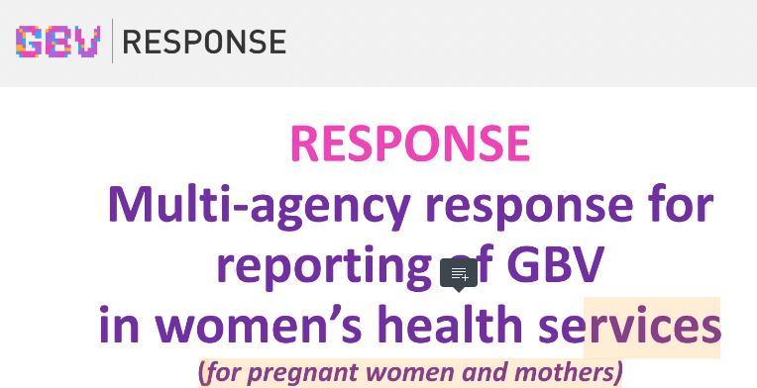
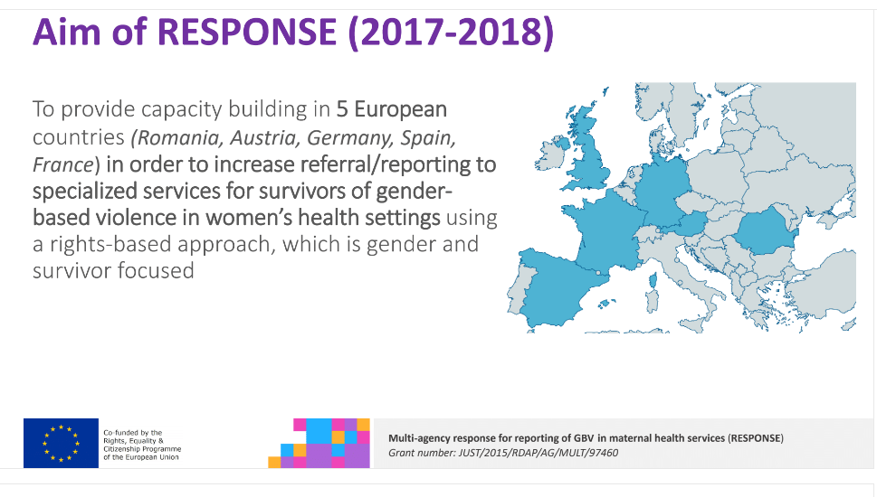
Health care capacity building
Based on earlier experiences:
IMPLEMENT (WAVE 2015-16) & UNFPA (2014 – 2015)

Slide 7
Stepped care multi sector communication principles
Describe signals
Concert with carers in own setting
Consult advisory- or reportcenter
Discuss ICE IA with client
Weigh risk violence
Decide how to assist
Securing safety
And/or report
Active Follow-up
Arrange protection
ASK
DISCUSS CONSULT
AGREE/ADVICE ASSESS
ASSIST: needs & safety
REPORT ASSURE FU
& SAFETY

Slide 8
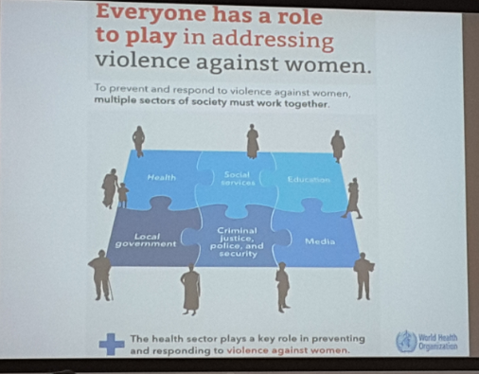
LEAVE SILLO THINKING
Do not blame your possible partners, but engage in collaboration !
Be aware of different case mix and large grey zone
t
Create space for anonymous advice 24h (?) & urgent (?)
Define a consensus based and feasible pathway and casemanagement including Health Care
Promote structural embedding of HC in the process & FJC (discuss how)
Management
Accessibility of services for HCP
Tasks distribution and agreement with sectors should includ Health Care
Created adequate information channel (what is that ?)
Agree sharing information in both directions
Make clear rules for confidentiality ànd transfer of other information
Attendance after referral / non attendance
Involved services and further referral
Information essential for care
Not only intake and release notes
Document short and long term protective effects and outcome

Slide 9
2. Be aware of different case mix and large grey zone
TOP OF ICEBERG : LAW
ENFORCEMENT
MIDDLE : SPECIALISED CARE
MENTAL CARE
BOTTOM : PRIMARY HEALTH
CARE & SOCIAL WELFARE

Slide 10
Structure communication
Do not blame your HC partners, but engage them in collaboration !
Be aware of different case mix and large grey zone
Empower health care services by feedback and support
Create space for anonymous advice 24h (?) & urgent (?)
Develop a consensus based feasible carepathway
Promote structural embedding of HC in this process & FJC (possible?)
Management
Accessibility of services for HCP
Tasks distribution and agreement with sectors should includ Health Care
Created adequate information channel (what is that ?)
Agree sharing information in both directions
Make clear rules for confidentiality ànd transfer of other information
Attendance after referral / non attendance
Involved services and further referral
Information essential for care
Not only intake and release notes
Document short and long term protective effects and outcome

Slide 11
Deal with barriers
Do not blame your HC partners, but engage them in collaboration !
Be aware of different case mix and large grey zone
Empower health care services by feedback and support
Create space for anonymous 24h (?) & urgent (?) advice
Define a consensus based and feasible pathway and casemanagement including Health Care
Promote structural embedding of HC in the process & FJC (discuss how)
Management
Accessibility of services for HCP
Multi Sectorial protocols should include Health Care Sector
Created adequate information channel (use IT?)
Agree sharing information in both directions
Consensus about confidentiality rules & transfer of information
Attendance after referral / non attendance
Involved services and further referral
Information essential for care
Not only intake and release notes
Document short and long term protective effects and outcome

Slide 12
Conclusion: 10 opportunities
Engage HC in positive collaboration !
Be aware of different case mix
Empower health care services
Create space for anonymous advice
Define a consensus based pathway including Health Care
Promote structural embedding of HC
Management
Accessibility for HCP
Tasks agreements should include Health Care
Create adequate information channel
Agree sharing information in both directions
Make clear rules for confidentiality , but always communicate:
Attendance after referral / non attendance
Involved services and further referral
Information essential for care
Not only intake and release notes
Document short and long term effects

Slide 13
DANK U WEL!
TEŞEKKÜR EDERIM
THANK YOU SO MUCH MUCHAS GRACIAS
ΕΥΧΑΡΙΣΤΩ
OBRIGADO TACK SÅ MYCKE
TAG MERCI BIEN

