Slide 1
International conference: how to start a Family Justice Center 1 December 2017, Royal Library, Brussels Belgium
Karen Vandekerckhove, Head of Unit,
Gender Equality, DG Justice and Consumers
European Commission

Slide 2
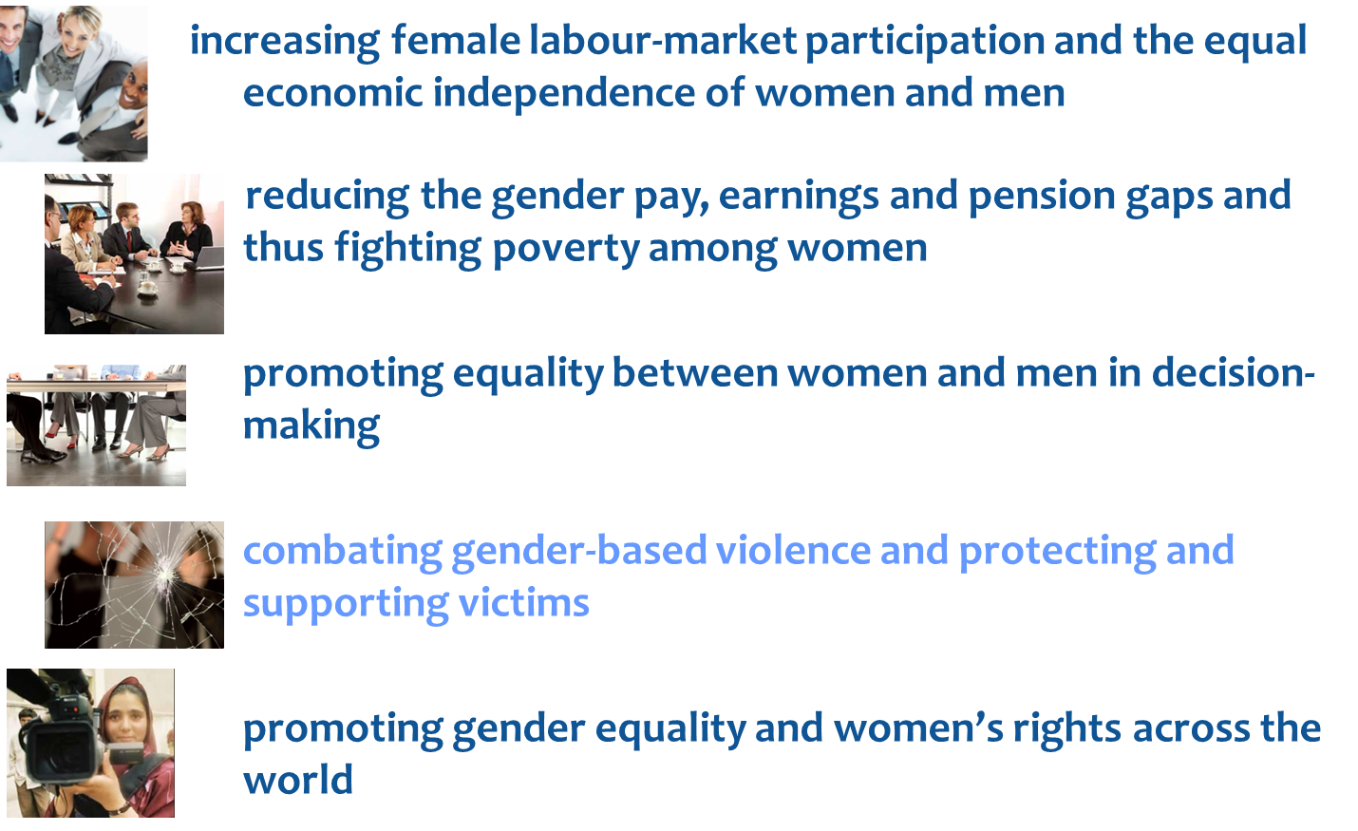
Strategic engagement for gender equality 2016-2019
Notes:
The framework in which our work of combating gender-based violence and protecting and supporting victims is strongly embedded, is our Strategic Engagement for gender equality. As you can see, the five priority areas all cover different aspects of gender equality. I would like to emphasize that even though some of these priorities are more labour market focused and some more fundamental rights focused, we believe they are two sides of the same coin and gender equality cannot exist when one of these is lacking. Gender-based violence is one of the harshest expressions of inequality between women and men. Women who are victims of violence are hindered in living their life to their full potential –they might have difficulties finding or holding a job, becoming economically independent and participate in society. On the other hand, when women have a job and an income, they might be able to act more adequately whenever they find themselves in situations of violence. Therefore, to us it is crucial that we make progress on all these different aspects of gender equality at the same time.

Slide 3
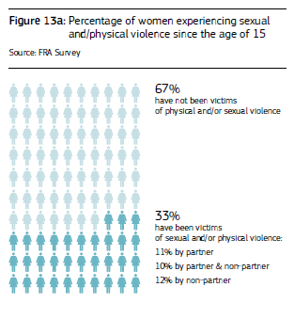
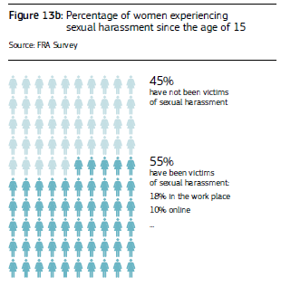
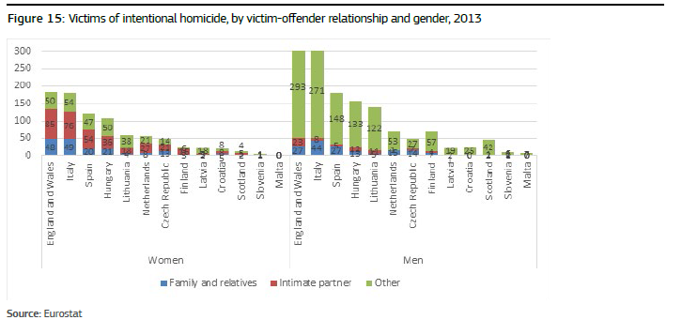
Notes:
Let me quickly touch upon the numbers that I'm sure you are all familiar with. In the EU, the EU Fundamental rights agency found in 2014, 1 in 3 women have experienced physical violence, sexual violence, or both, since they were 15 years old. 55% of women have experienced sexual harassment. When we look at women in management positions or professionals such as doctors or lawyers, this number goes up to 75%. 1 in 20 women have been raped, and 1 in 10 have experienced harassment online. It will not surprise you that the number is significantly higher for women under 30.
The FRA survey is not the only source of information we have. It is interesting to have a look at administrative data as well. Eurostat, in cooperation with the United Nations Office on Drugs and Crime (UNODC), collected crime data from police and justice systems and published the initial results in September 2015.56 The data show that, in many Member States, over half of female murder victims are killed by an intimate partner, relative or family member.
Taking a look at the scale, I guess we can conclude that violence against women impacts our societies in a profound manner.

Slide 4
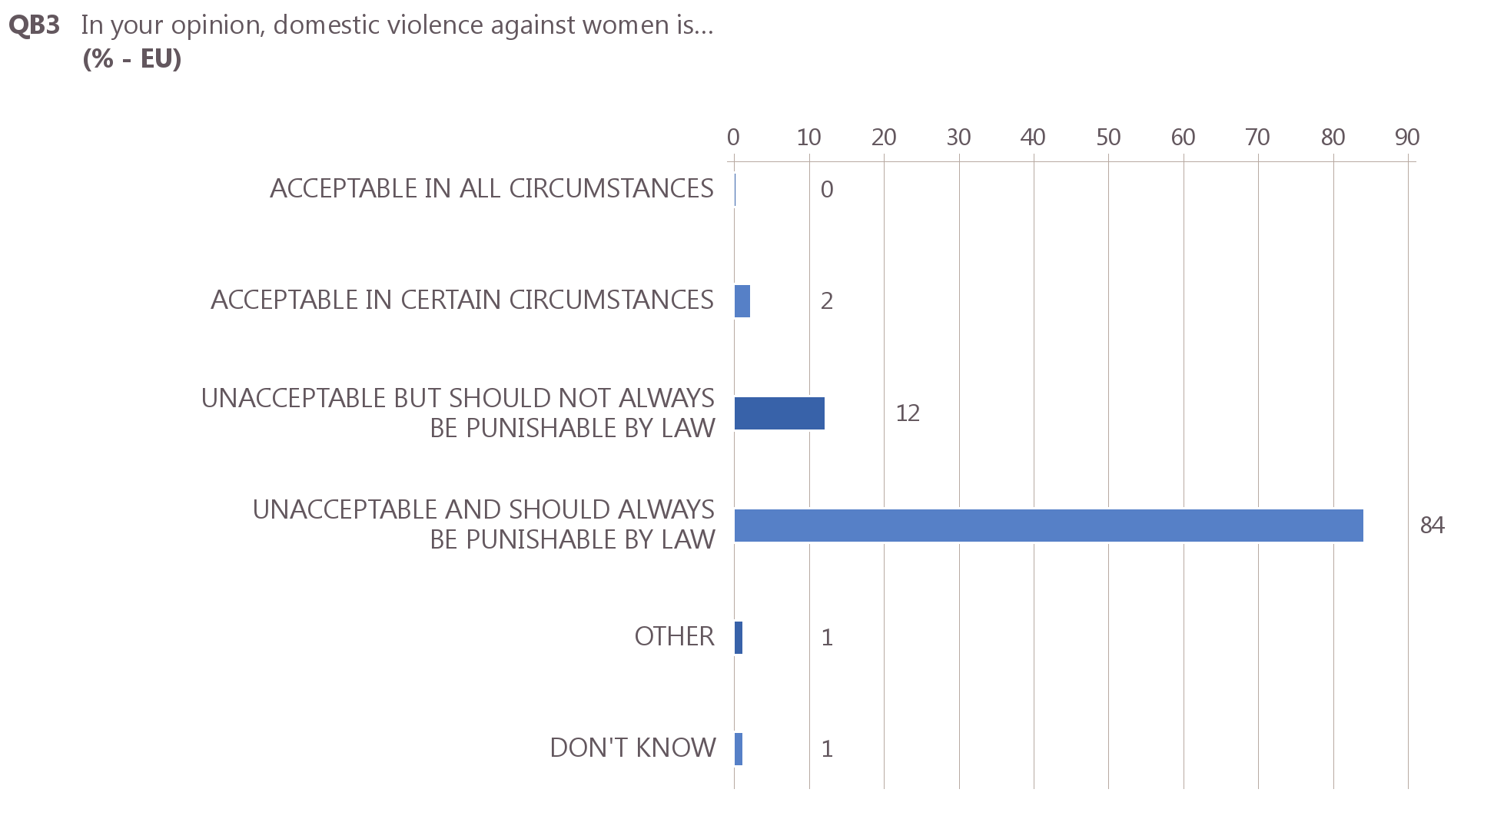
84% of citizens believe domestic violence against women should be punished by law
Notes:
Last year, we carried out a Eurobarometer survey on violence against women. There are some findings that I would like to highlight. An overwhelming majority of EU citizens believe that domestic violence against women should be punished by the law.

Slide 5
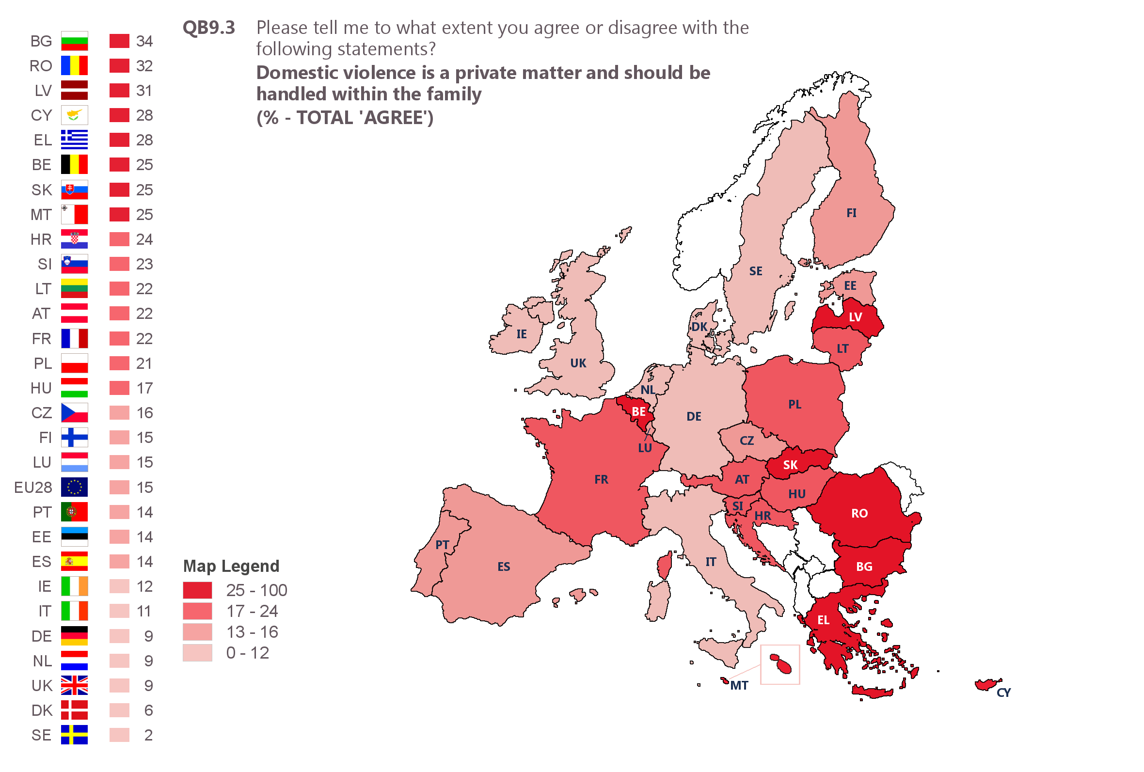
15% agree domestic violence is a private matter that should be handled within the family although this varies by Member State
Notes:
But there is still an important portion of people that believe domestic violence is instead a private matter that should be handled within the family. As you can see, these attitudes vary across Europe. In Belgium, 1 in 4 people hold such views.

Slide 6
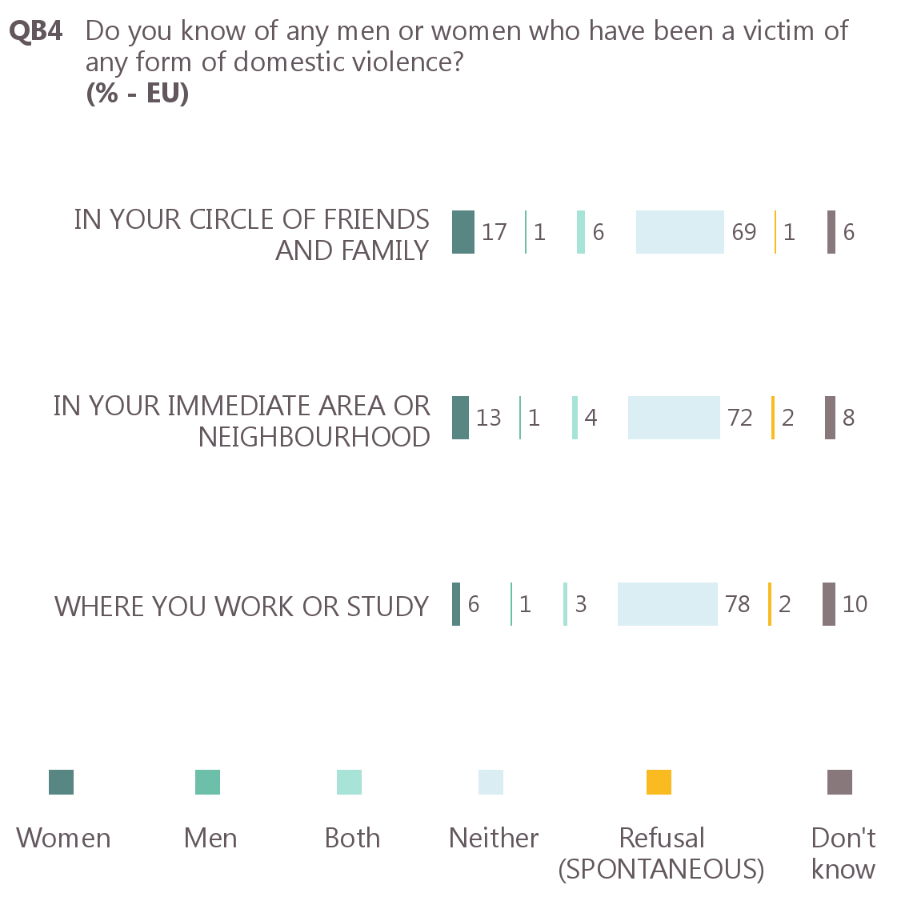
Almost one quarter of respondents know someone amongst friends or family who has been a victim of domestic violence
Notes:
About one in four respondents know someone that has been a victim of domestic violence, either in their circle of friends and family, their immediate area of neighbourhood, or at work or study.

Slide 7
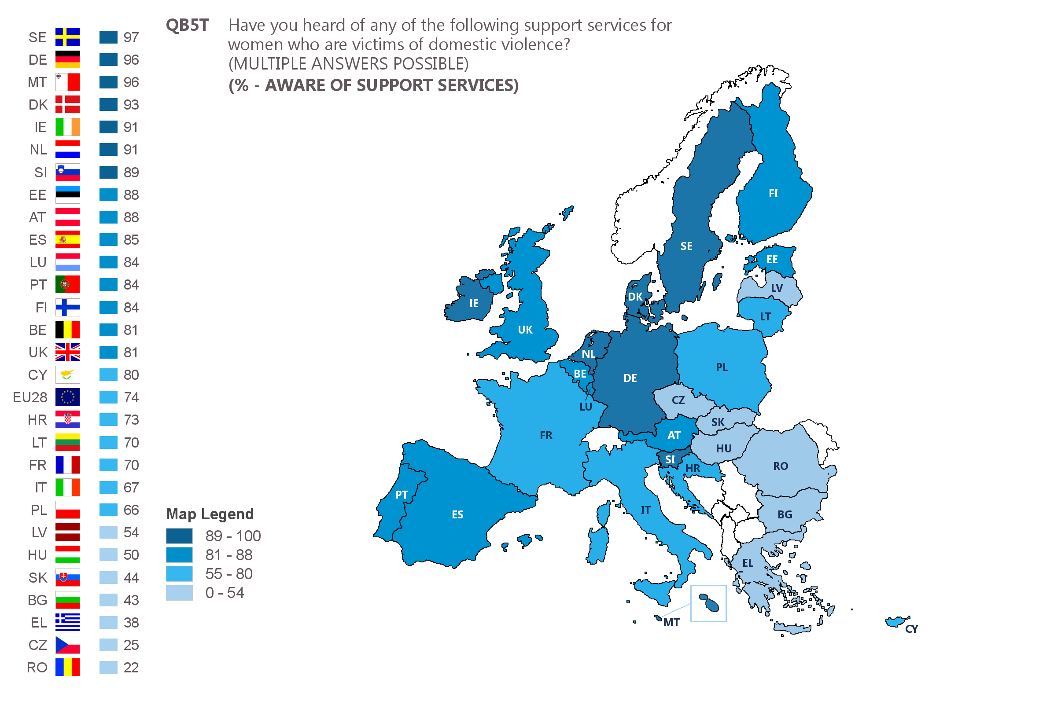
Almost three quarters are aware of support services but this varies by Member State
Notes:
And about 3 in 4 people are aware of support services – in Belgium this is even higher at 81%. But when asked whether they have spoken with someone about the domestic violence they are aware of,

Slide 8
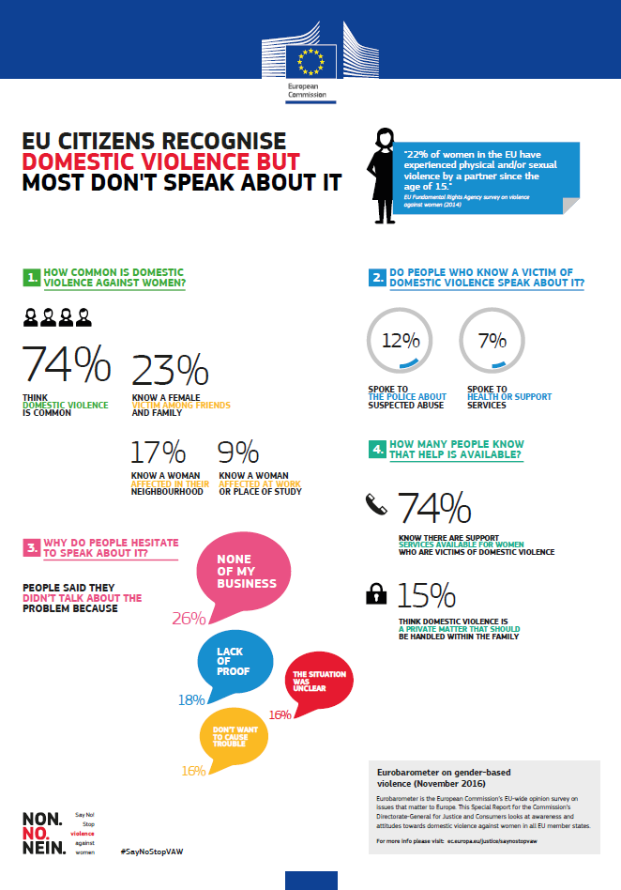
Notes:
They will say its none of their business, they have a lack of proof, they're not certain or they didn't want to cause any more trouble. I'm highlighting this because it is clear that there is still work to do in this area: when support services, such as the family justice centres, are available, it is of utmost importance that people are directed towards these services.

Slide 9
LEGISLATION & POLICIES
Trafficking
Child abuse
European Protection Orders
Sexual harassment
Minimum rights for victims
EU accession to Istanbul Convention
What is the Commission doing?
Notes:
The European Commission has introduced a package of legislative measures to ensure victims are effectively protected. The Victims' Directive, to take effect in November of this year, will guarantee a certain number of rights to all victims of crime, including victims of gender-based violence, ensuring that:
they are treated with respect by well-trained police, prosecutors and judges and get understandable information on their rights;
they can get specialised support in all EU countries;
they can participate in proceedings and have procedural rights, e.g. right to be heard, right to legal aid, right to interpretation and translation, right to review a decision not to prosecute; and
they are protected from secondary and repeat victimisation, from intimidation and from retaliation during police investigations and court proceedings.
The European Protection Orders, meanwhile, entered into force in January of this year and ensure that restraining and protection orders issued in one EU country are recognised across the EU. Thanks to this, women who have suffered domestic abuse are protected if they travel or move anywhere in the EU.
The EU is now guiding MS in the application of this legislation and monitors implementation.

Slide 10
Minimum rights for victims
LEGISLATION & POLICIES
Trafficking
Child abuse
European Protection Orders
Sexual harassment
EU accession to Istanbul Convention
Fundamental Rights Agency
EIGE
Eurostat
DATA COLLECTION
Eurobarometer
Member States
What is the Commission doing?
Notes:
Reliable data on the prevalence and causes of gender-based violence are crucial for the design of appropriate policy responses and for monitoring of the situation across the EU.
I have already mentioned the survey of women's experiences of violence by the Fundamental Rights Agency, that revealed disturbingly high levels of violence in every country of the EU. It represents a very good starting point – it was the first-ever EU-wide survey on this topic.
The Commission is now building on this experience and taking a two-fold, complementary approach, using EUROSTAT and national statistical offices, and the expertise of the European Institute for Gender Equality (EIGE).
EUROSTAT, in cooperation with national statistical offices, started in 2014 to collect more detailed administrative crime data. The Commission is also actively collaborating with the European Institute for Gender Equality (EIGE) to improve data collection on gender-based violence. EIGE has produced research on female genital mutilation, for example and it has just presented the Gender Equality Index.

Slide 11
Minimum rights for victims
LEGISLATION & POLICIES
Trafficking
Child abuse
European Protection Orders
Sexual harassment
EU accession to Istanbul Convention
Fundamental Rights Agency
EIGE
Eurostat
Member States
DATA COLLECTION
Eurobarometer
What is the Commission doing?
ELIMINATING FEMALE GENITAL MUTILATION
Knowledge
Prevention
Prosecution
Protection
External dimension
Notes:
There is a European Communication towards the elimination of female genital mutilation; I won't elaborate on that now but wanted to point it out as one of our specific area of action.

Slide 12
Minimum rights for victims
LEGISLATION & POLICIES
Trafficking
Child abuse
European Protection Orders
Sexual harassment
EU accession to Istanbul Convention
Fundamental Rights Agency
EIGE
Eurostat
Member States
DATA COLLECTION
Eurobarometer
What is the Commission doing?
ELIMINATING FEMALE GENITAL MUTILATION
Knowledge
Prevention
Prosecution
Protection
External dimension
FUNDING
Awareness-raising campaigns by Member States
European networks
Grassroots projects by NGOs
Notes:
We are also providing funding for civil society organisations through our Rights Equality and Citizenship Programme. These are organisations and networks combating violence against women and normally transnational grassroots projects that make a real change for women and girls, and men and boys, in Europe.
To improve the support victims of violence receive, it is crucial that different service providers and professionals work together. The family justice centres show this in a compelling manner. Recently, we have also funded other projects who aim to improve the chain-approach by training professionals and enhancing cooperation between different services. This includes not just cooperation with police and justice services, but also for example housing providers where caretakers are trained in spotting the signs of violence, and knowing how to respond. We also support national authorities to improve the cooperation between services, such as for example in Iceland where police and social services are piloting a way of working that has proven successful in increasing reporting and making the services to victims more visible and accessible to vulnerable groups of women.

Slide 13
REC Funding programme
Total budget (2014-2020) and annual budget
Rights, Equality and Citizenship Programme
440 million euro
63 million euro/year
Notes:
The total budget of the programme is 440 million euro, which equals 63 million euro a year.

Slide 14
REC Programme Funding areas
Non–discrimination and Roma integration
Racism, xenophobia, homophobia
Rights of persons with disabilities
Gender equality
Daphne - Prevent violence against children, young people, women and groups at risk
Rights of the child
EU Citizenship
Data protection
Consumer rights
Notes:
There is only a portion of this that is earmarked for projects that aim to prevent violence against children, young people, women and groups at risk.

Slide 15
Timetable for calls
The 2018 REC Annual Work Programme is to be formally adopted in December 2017.
Once adopted, it will be published under:
http://ec.europa.eu/justice/grants1/programmes-2014-2020/rec/index_en.htm
Notes:
The 2018 annual work programme will be adopted this month, and you can have a look at our website to read it.

Slide 16
5. Selected projects
DAPHNE toolkit (2007-2013 Daphne programme)
http://ec.europa.eu/justice/grants/results/daphne-toolkit/en/daphne-toolkit-%E2%80%93-active-resource-daphne-programme
Published summaries of selected projects
On DG JUST website and Participant Portal
Notes:
If you would like to see what types of projects have been funded before, you can also do that on our website, as well as in the daphne toolkist, where you can search for projects that have been funded previously.

Slide 17
http://ec.europa.eu/justice/gender-equality/gender-violence/index_en.htm
Karen.Vandekerckhove@ec.europa.eu
@EU_Justice
Notes:
I wish you a very fruitful conference, and

