Slide 1
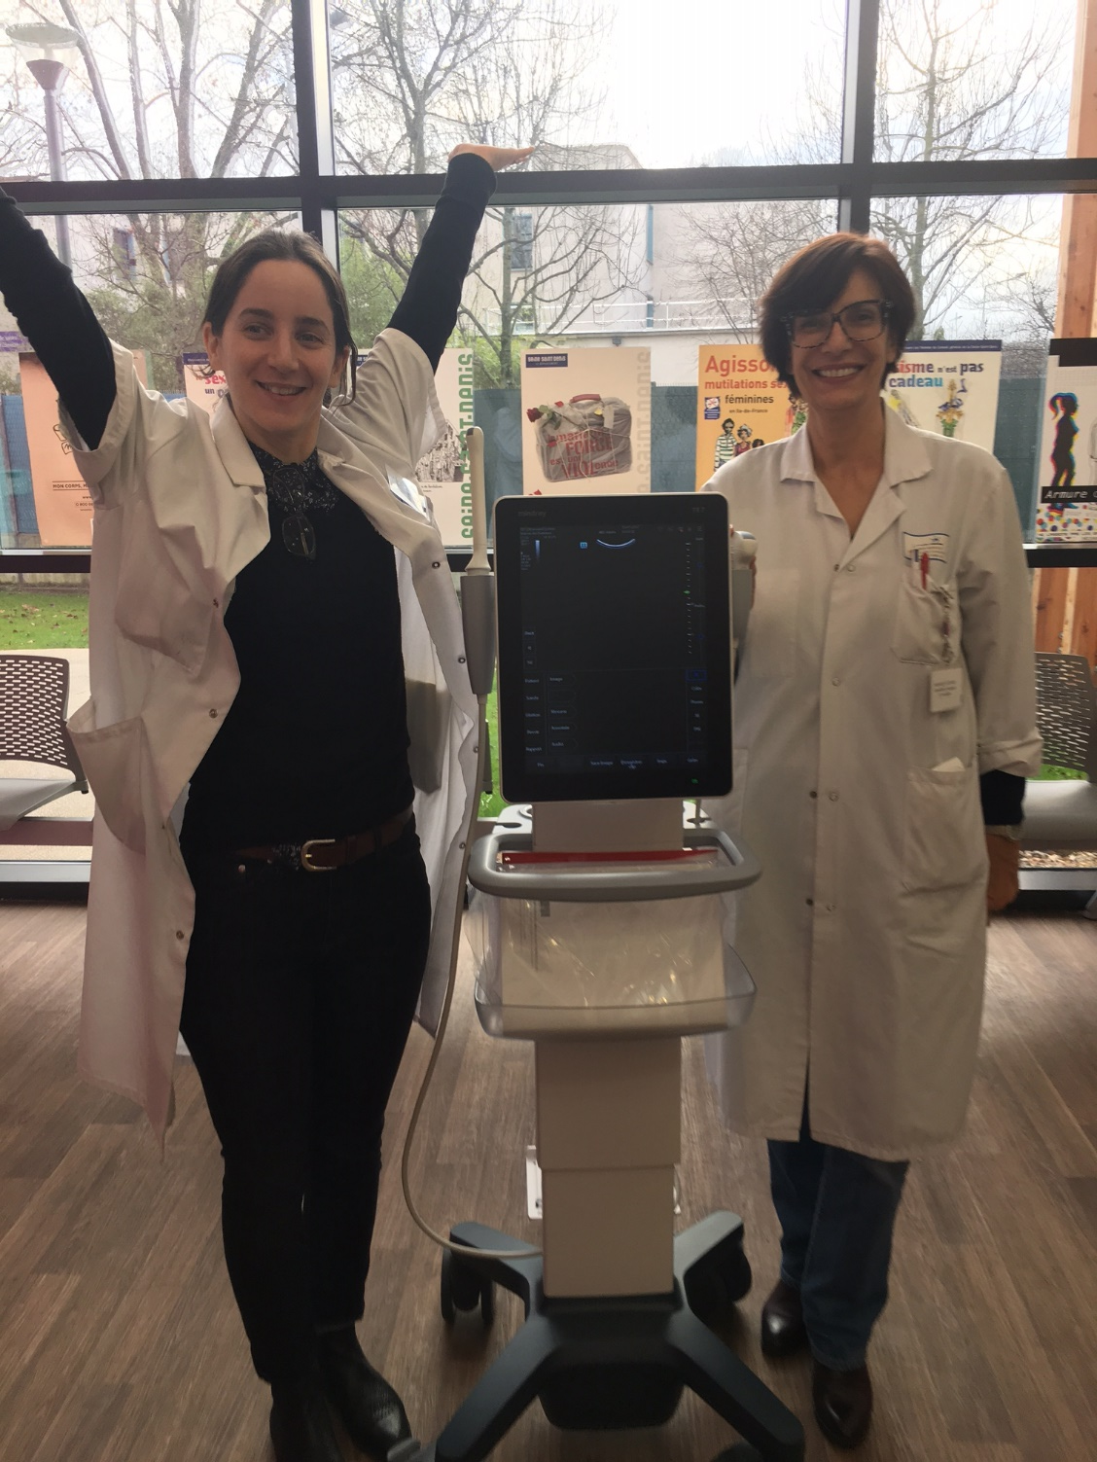
FROM CURING TO CARING
Family Justice Center Alliance
International Meeting
December 1st 2017

Slide 2
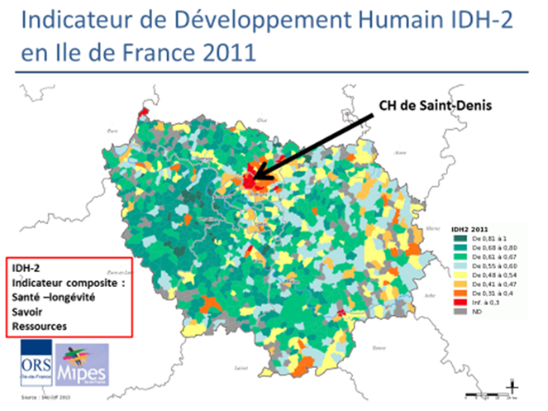
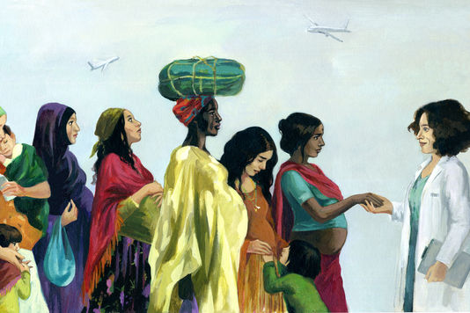
How a vision…
Witnessing the gap:
4,600 births per year at Delafontaine Hospital
200 women sent back on the streets with a newborn
14 percent of mothers having been excised
Extremely precarious conditions, especially in women 16 to 40 years old
Excessive perinatal mortality
And a lack of solutions:
A family planning center located in a corner of the maternity
Lack in coordination of care, and powerless caregivers

Slide 3
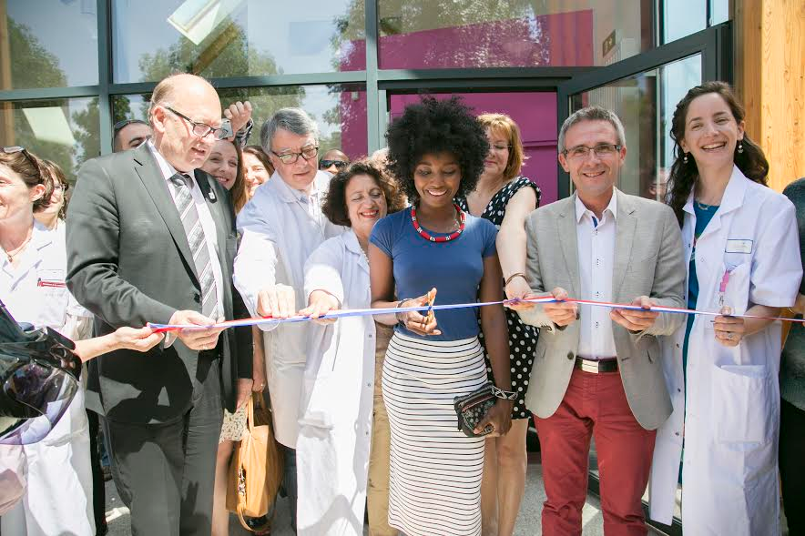
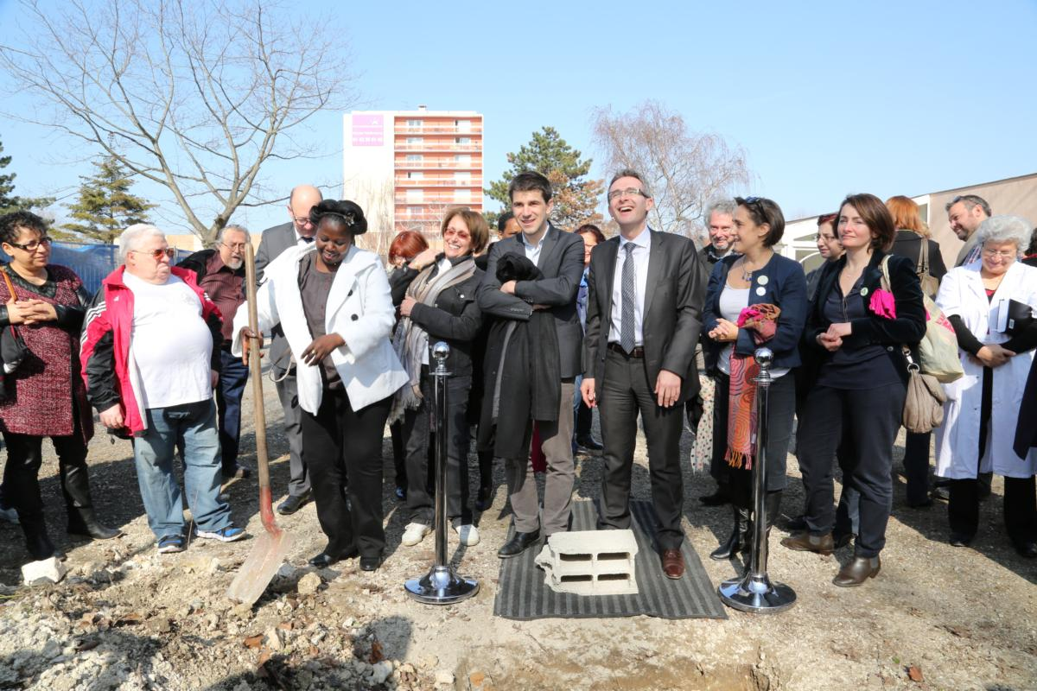
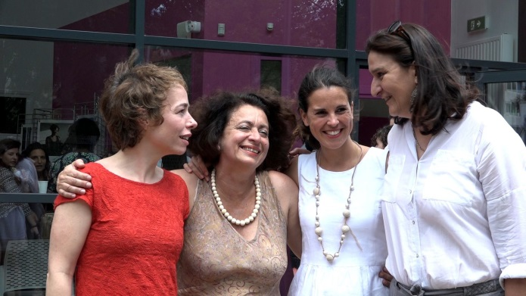
8/3/2014: First foundation stone ceremony
… Turns into reality
August 2013: first meeting with the Kering Foundation
October 2013: the Foundations’ Club meets with Dr Hatem
November 2013: launch of the first Inter-Foundations project
January 2015: first crowdfunding campaign
December 2013-May 2015: lobbying, political awareness campaigns
September 2015: beginning of the construction
15/07/2016 Inauguration

Slide 4
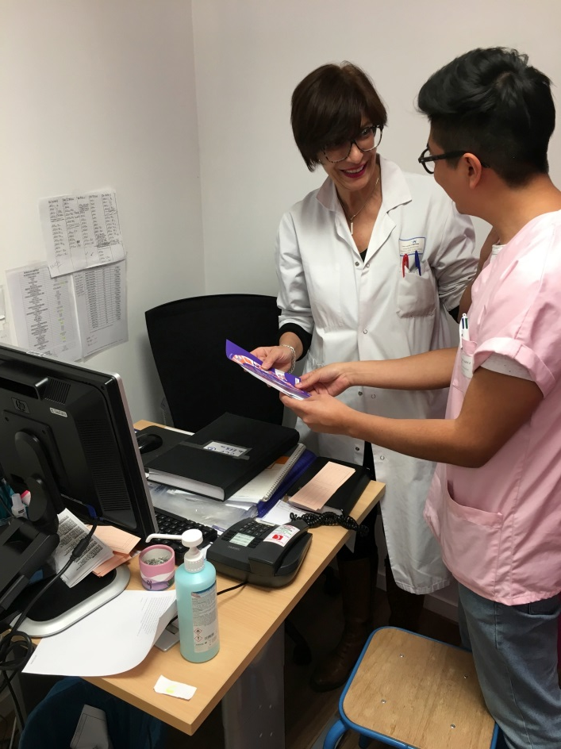
La Maison des Femmes de Saint-Denis
A walk-in structure for vulnerable women and victims of violence: holistic patient care that offers medical, psychological, legal, social, and well-being support services
“One-Stop Shop” model with three care units: FGM, violence, family planning
Immediate response and coordination of care
Innovative facility, unique in France

Slide 5
FGM: How we help
Follow up:
Gynecologist appointments
Therapist/sexologist
Legal aid
Wellbeing approach
Detecting FGM:
Mutilation detected in maternities/health centers/organizations/emergency rooms
Taking care of patients
Midwife-gynecologist
Therapist/sexologist
Support group
Team meeting to decide on procedure to follow
Medical follow up and/or intervention
Spokesperson in their community

Slide 6
Violence: How we help
Planning out the care and rehabilitation pathway
Psycho-medical support
Legal and social support
Police representative
Lawyer
Facilitators for legal and administrative processes
Participation to different workshops
Screening for violence: General practitioner/ENT/social assistant/emergency room/maternity/organizations/schools
Care taking: with or without appointment
Midwife and/or FP counselor

Slide 7
Family Planning: How we help
Counseling
Couples Therapy
Sexual and reproductive health education
Social support
Seeking for help in reproductive health
Pregnancy follow up: Provision of information
regarding rights and resources available
Walk-in structure: Diagnosis, treatment, contraception, abortion, morning after pill,

Slide 8
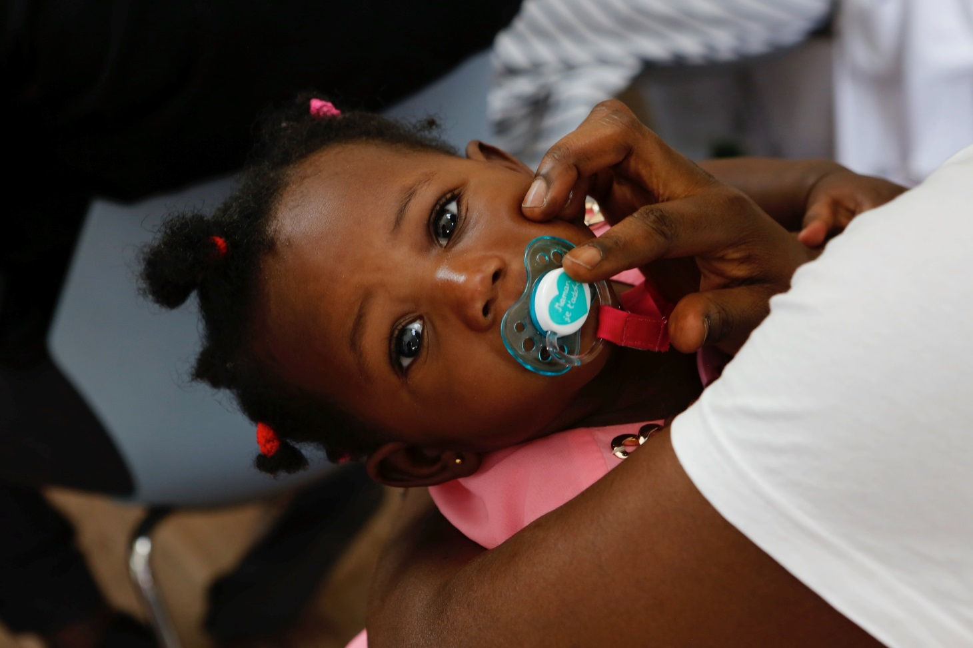
10 714 CONSULTATIONS IN ONE YEAR !

Slide 9
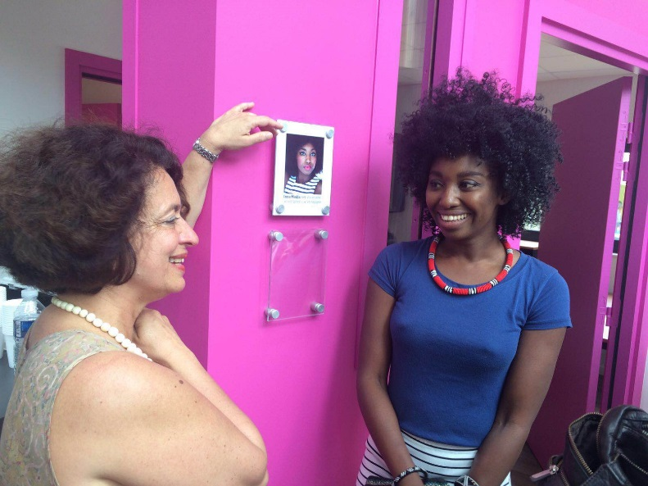
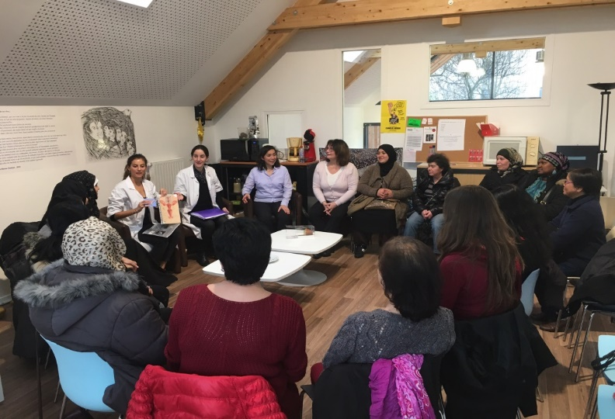
National Partnerships
A weekly support as well as individual therapeutic sessions group for survivors hosted by SOS Femmes 93, a specialist organization on DV
Inna Modja, a Malian singer survivor of FGM, moderates a monthly support group for women having gone through FGM
Weekly presence of a retired policeman who manages individual information session
Lawyers specialized in violence and migration law
Support to several initiatives from the Ministry of Women’s Rights (Excision Parlons-En, Femmes en Lutte)
The City of Saint-Denis and Villepinte, to promote sexual health and gender equality in middle and high schools
Association Artistica : Sexual health classes to women in the process of learning french
Training medical professionals in the region to screening violence

Slide 10
The staff
Family planning unit team
A coordinating midwife specialized in violence against women
An administrative agent,
A part-time secretary for the violence and FGM units
A part-time midwife for the violence unit
Twice-a-month consultation on child abuse/incest
2 shifts of psychologists
A sexologist shift
A forensic doctor
Monthly therapeutic supervision for the Maison des Femmes staff
Social worker funded by the County of Seine Saint Denis, who supports women in administrative work, in-person care
A program manager
2 surgeons

Slide 11
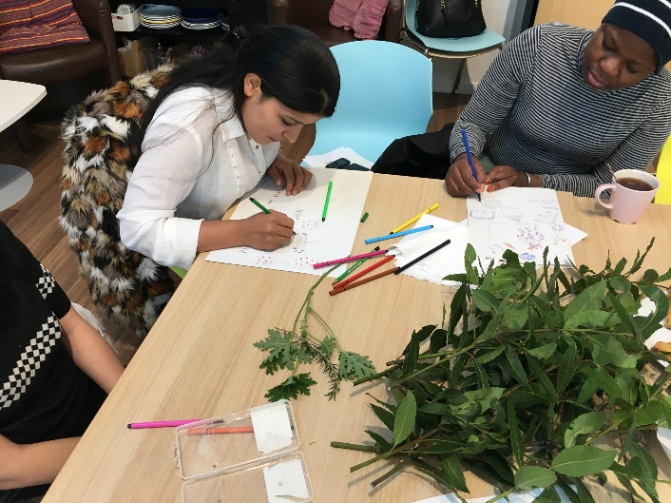
Volunteer support
Physical well-being support from 2 osteopaths, 3 gynecologists, 1 Ayurveda masseuse
Legal support by 3 part-time lawyers
Various cultural and self-esteem activities animated by volunteers:
Visits to the French National archives,
Theatre week-long programs,
Writing workshops,
Cooking classes, drawing lessons, jewelry-making sessions, sewing classes,
Gardening year-long project
Two “institutional affairs/Advocacy” experts on relationships with French ministries
One volunteer in charge of fundraising and crowd-funding
A renown epidemiologist to monitor the impact evaluation of our actions on the lives of women with the support of the programme manager

Slide 12
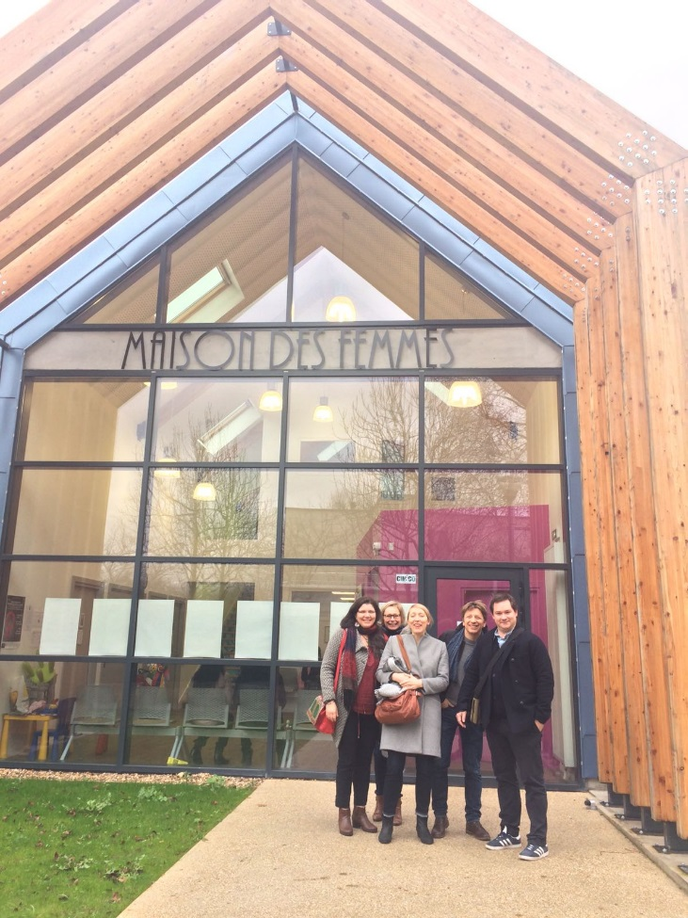
International Partnerships
CHU Saint-Pierre in Brussels, which just opened the second Maison des Femmes based on our model
Partnership with « Cèdres-Liban » Lebanese Foundation and with the KAFA VAW organization
« Desert Flower » Label with the project of an international conference gathering all European Center working on FGM
Label from the UNESCO Chair in Sexual Health and Human Rights for our work against FGM

Slide 13
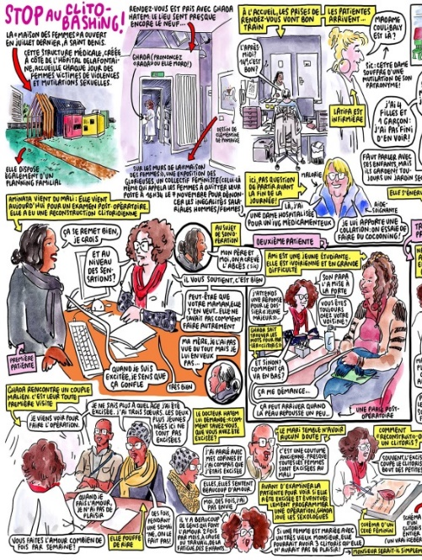
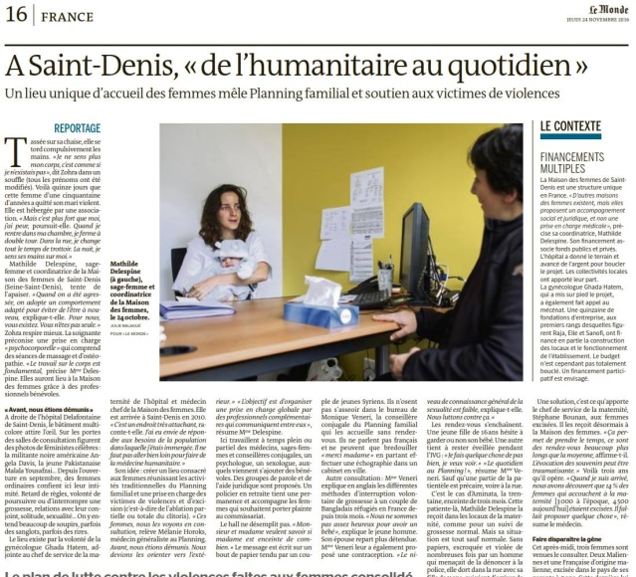
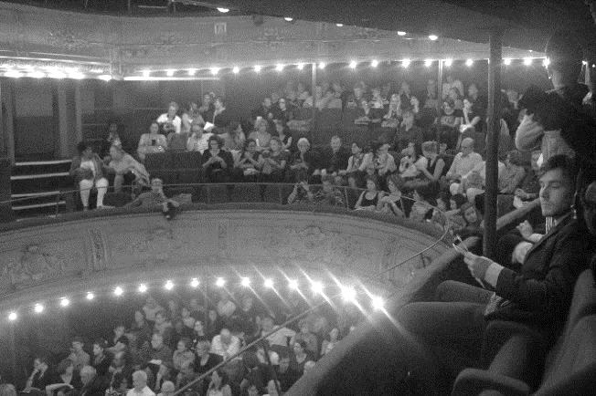
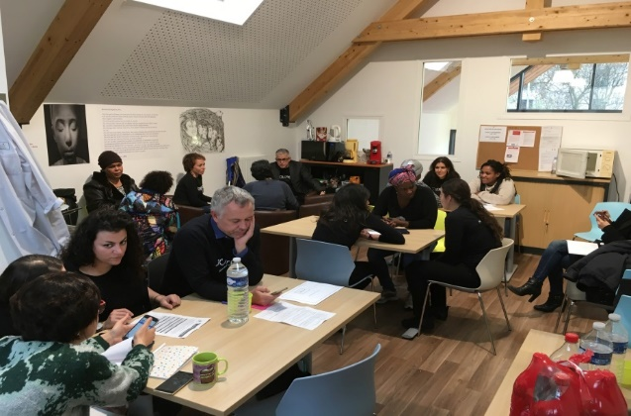
Communication & Fundraising
Uninterrupted media presence since July: Articles, TV, radio, documentaries – in France and abroad
Two successful online crowdfunding campaigns
Important Facebook/Twitter/Instagram presence
Kering Solidarity Day 2016 – 2017
Film premieres, exhibits, book promotions

Slide 14
What’s next?
EXPAND !
In France and abroad
Advocacy and lobbying to model and disseminate similar structure
And, recruit more Family Justice Centers in France

