Slide 1


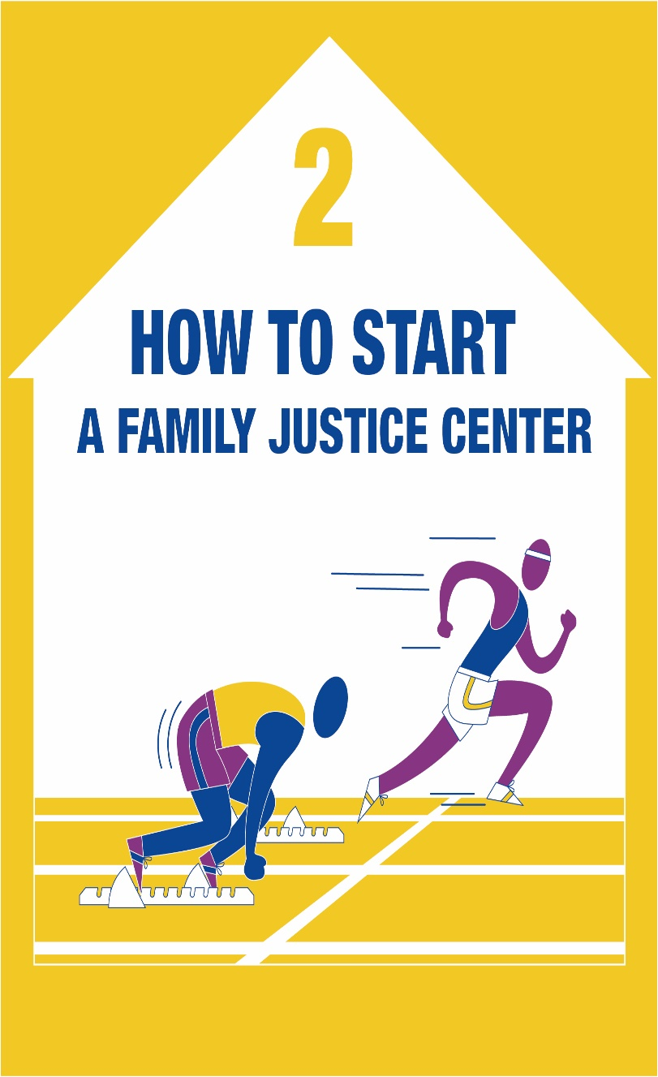
European Family Justice Center Alliance
www.efjca.eu

Slide 2


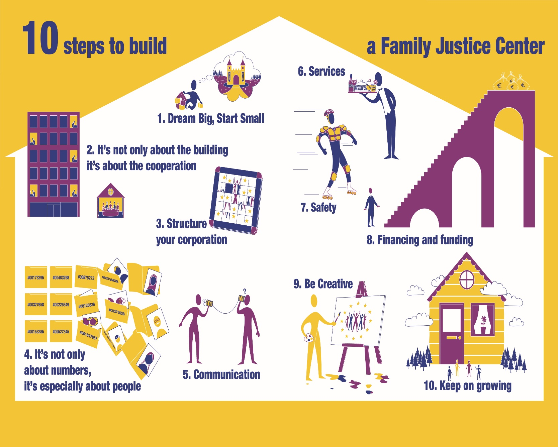
European Family Justice Center Alliance
www.efjca.eu

Slide 3


1. Dream Big, Start Small
European Family Justice Center Alliance

Slide 4

Where do I start?
Start with what you have…
Start where you are…
BUT…
START WITH YOUR COMMITMENT TO FIND THE BEST WAY TO STOP VIOLENCE!!!

Slide 5

You, the first to be committed!
It all starts with you! You are the first to be persuaded that the Family Justice Center model is the most effective way to cope with the problem of domestic violence.
Without your commitment, be sure that nothing is going to happen…
Family Justice Center model, like all the innovations, requires strong and motivated leaders

Slide 6
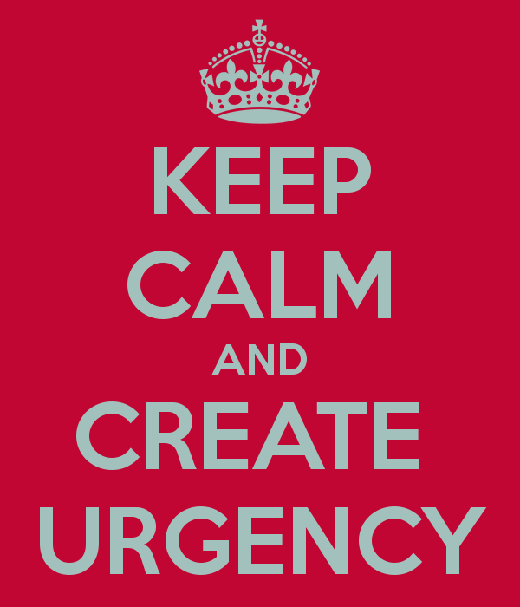
How to start ?

Slide 7

Look around you!
It’s crucial to assess the situation in your context about services and resources on domestic violence.
The need for implementing the FJC has to be the natural consequence of a deficit you can prove with evidences from the context around you.
Remember to assess what’s missing and what’s working in your country and your local community

Slide 8
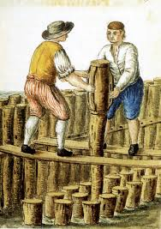
The solid ground to build up
The Family Justice Center model is now a recognized best practice because it proved to be an effective answer to these impelling questions:
The need for collaboration and integration to cope with complex issues
The need to simplify the service we offer to the client (avoiding fragmentation and dispersion)
The need to save money and foster efficiency

Slide 9

INTEGRATION
The need for collaboration and integration to cope with complex issues

Slide 10

SIMPLIFICATION
The need to simplify the service we offer to the client (avoiding fragmentation and dispersion)

Slide 11
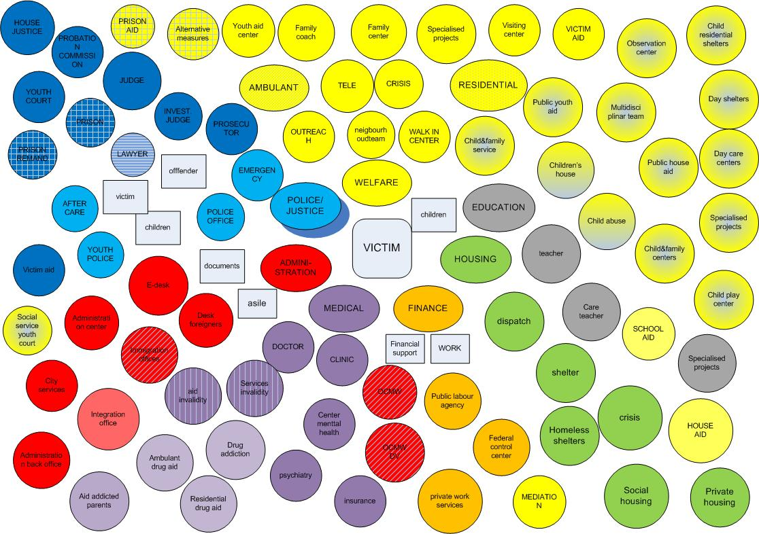

Slide 12

EFFICIENCY
The need to save money and foster efficiency

Slide 13
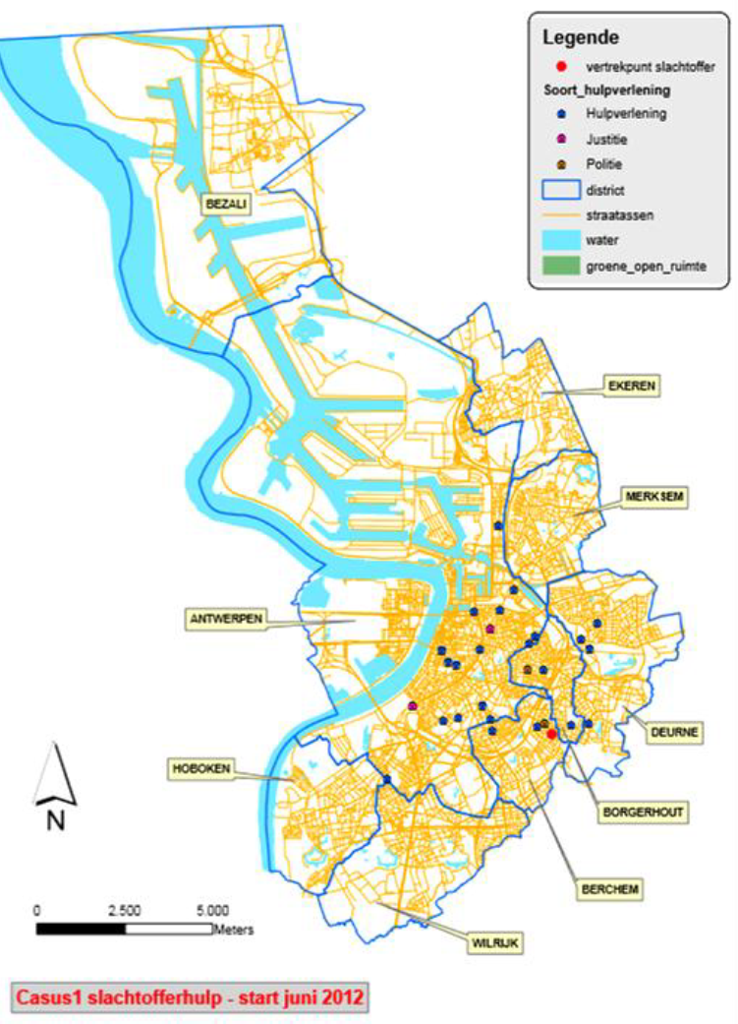
???
Can you use it somewhere else?

Slide 14
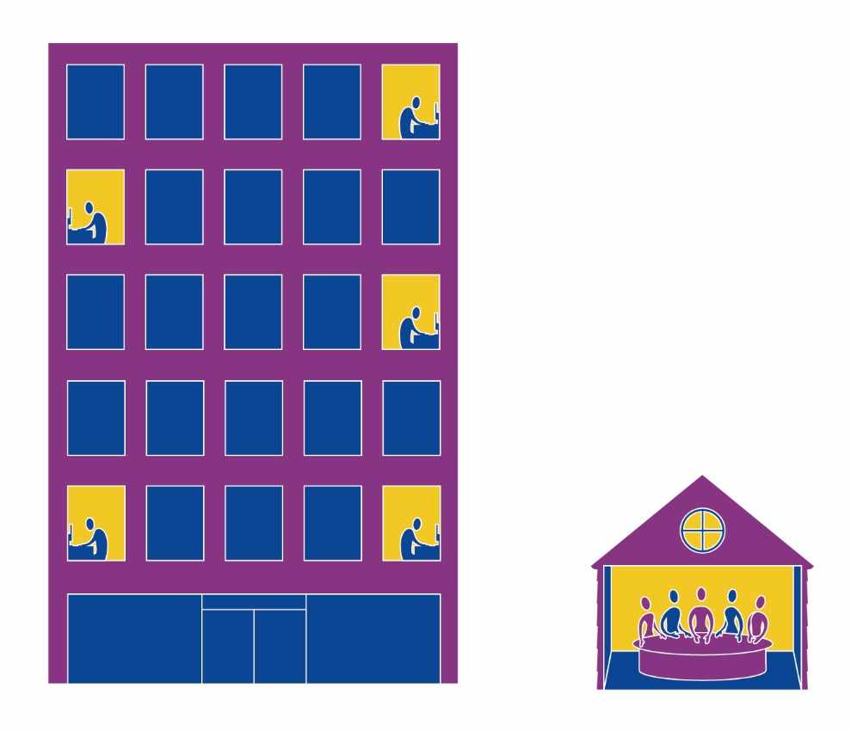
2. It’s Not About the Building, It’s About The Cooperation
European Family Justice Center Alliance

Slide 15
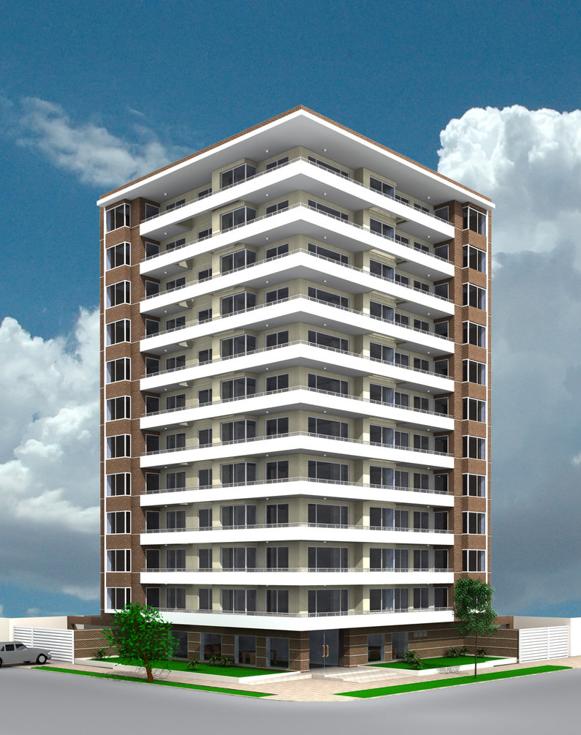
All under the same roof?
One roof is not enough...
What’s really crucial is COOPERATION:
- Working together under the same roof
- Finding ways to cooperate focusing on the client
Notes:
Pascale

Slide 16
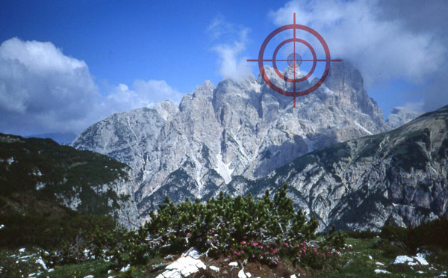
Cooperation
Different actors (public and private agencies) are called to deeply share A Common Goal:
Stop the violence, prevent recurrence of violence and empower clients
Notes:
Pascale

Slide 17

Cooperation
Form a Coalition
  By equals (under the same rules)
  Need each other (interdependency)

Slide 18

Choosing the right moment
There is a time for everything…
Build momentum around your project, taking advantage of:
High level of attention to the issue of domestic violence in the public opinion and the media
Financial and economic pressures on public institutions
Special commitment to the issue by some politicians and opinion makers

Slide 19
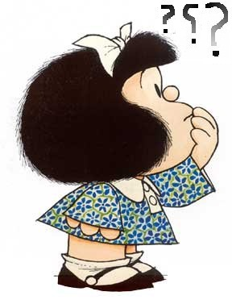
Caution! Not all communities are ready…
Key Steps in the journey:
  Domestic Violence Task Force/Council
  Specialized Units (Police/Prosecutors)
  DV Court
  Protocols
  Developed strong working relationships
  Still like each other?
  Buy in from key stakeholders for colocation

Slide 20
3 is a crowd
Video dancing guy leadership 2 minuten
????

Slide 21
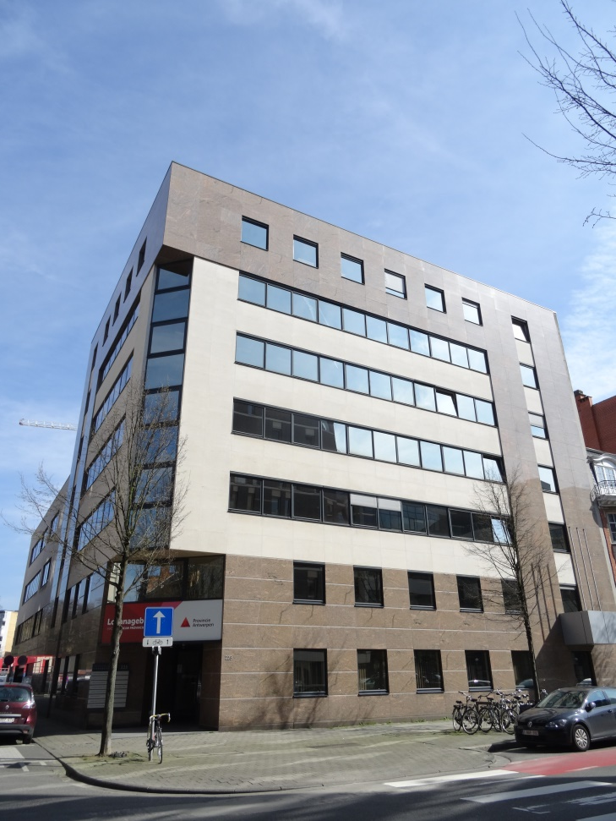
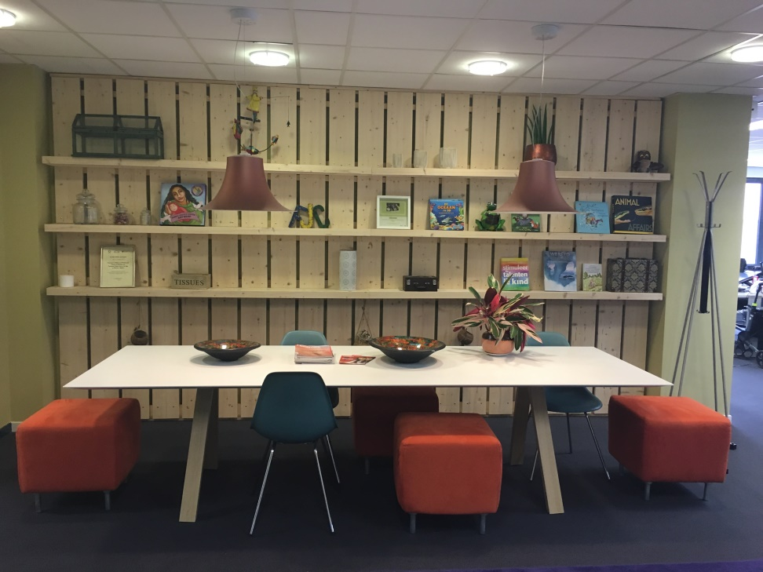
Outside vs. Inside

Slide 22
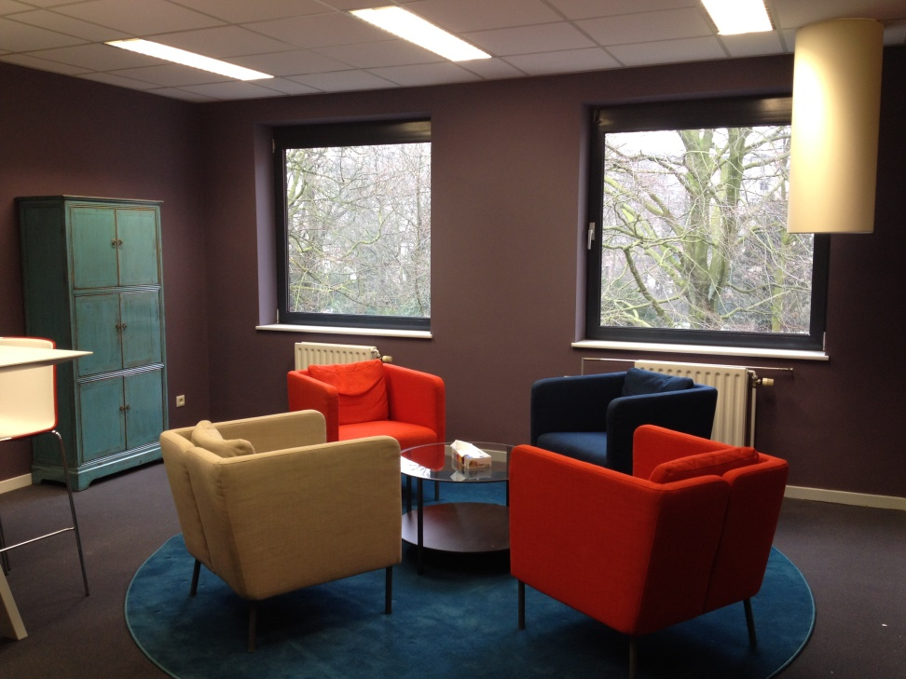
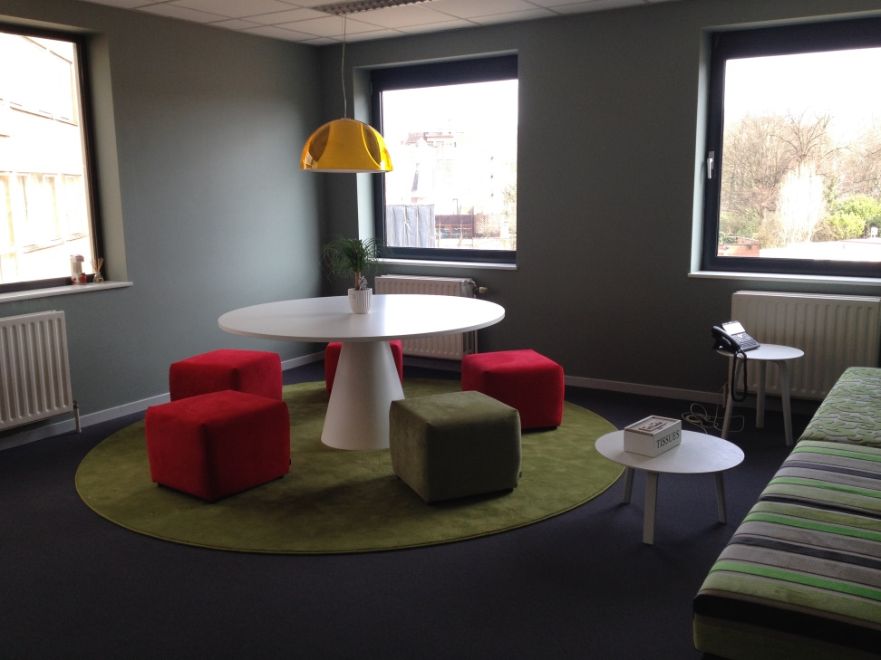
Meeting rooms

Slide 23
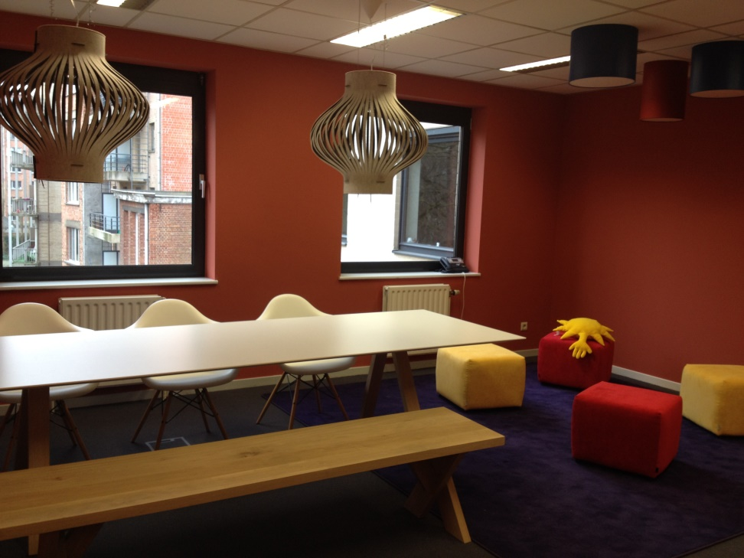
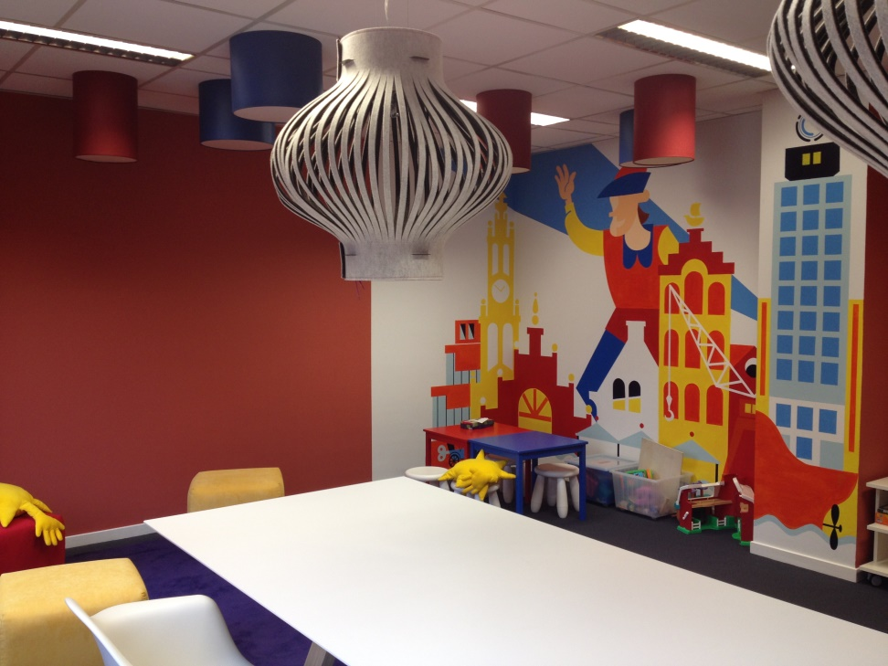
Place for Children to Play

Slide 24

3. Structure Your Organization
European Family Justice Center Alliance

Slide 25

Structure
Strategic Plan
Processes
Describes roles
Decision Structure and leadership
Script

Slide 26
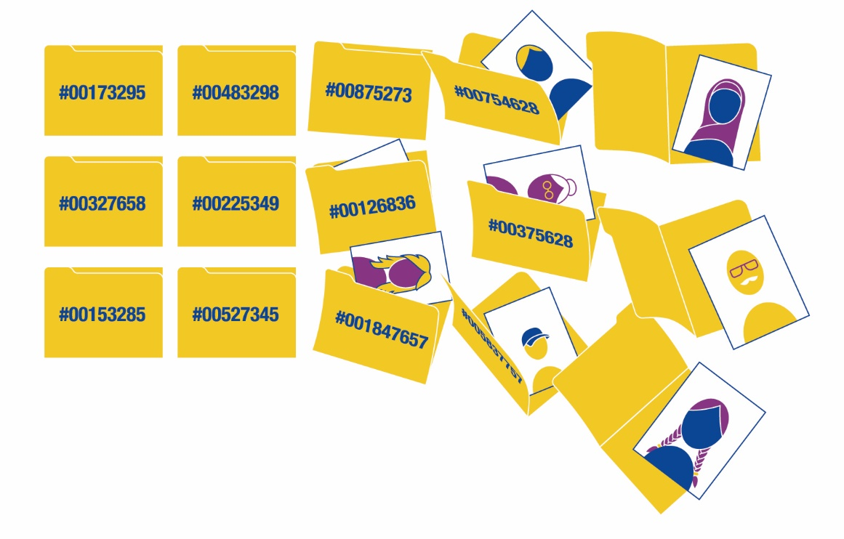
4. It’s Not Only About Numbers, It’s About People
European Family Justice Center Alliance

Slide 27
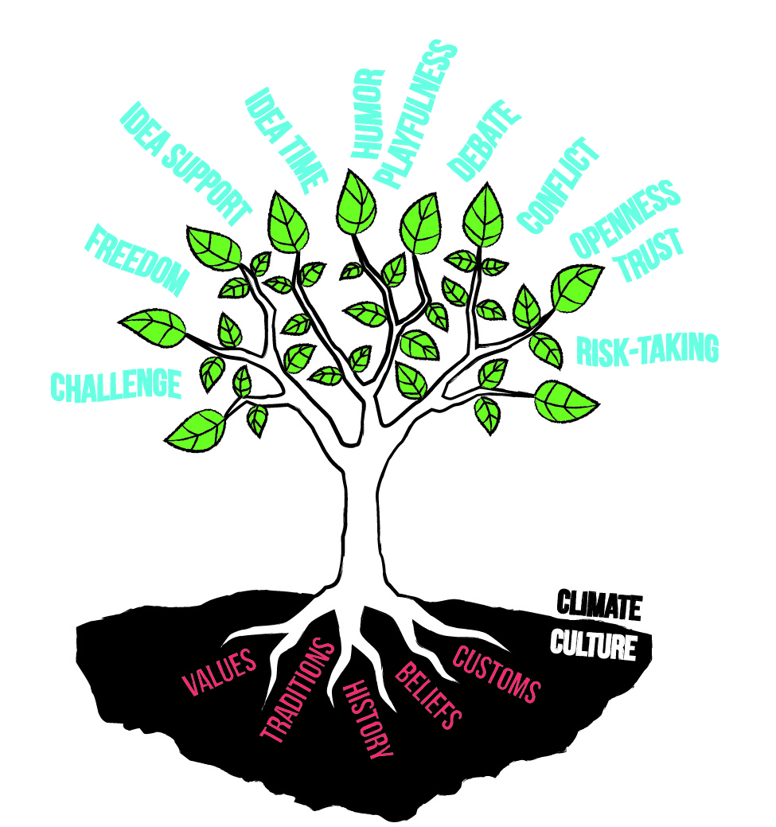
People: climate & culture

Slide 28

Humor & playfullness
How do you measure humor ?

Slide 29
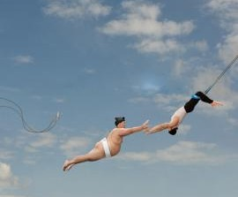
Trust
Talk the Talk
Don’t misuse information
Openess
Ventilate
Quick Wins
Helpfull
Mercyfull

Slide 30
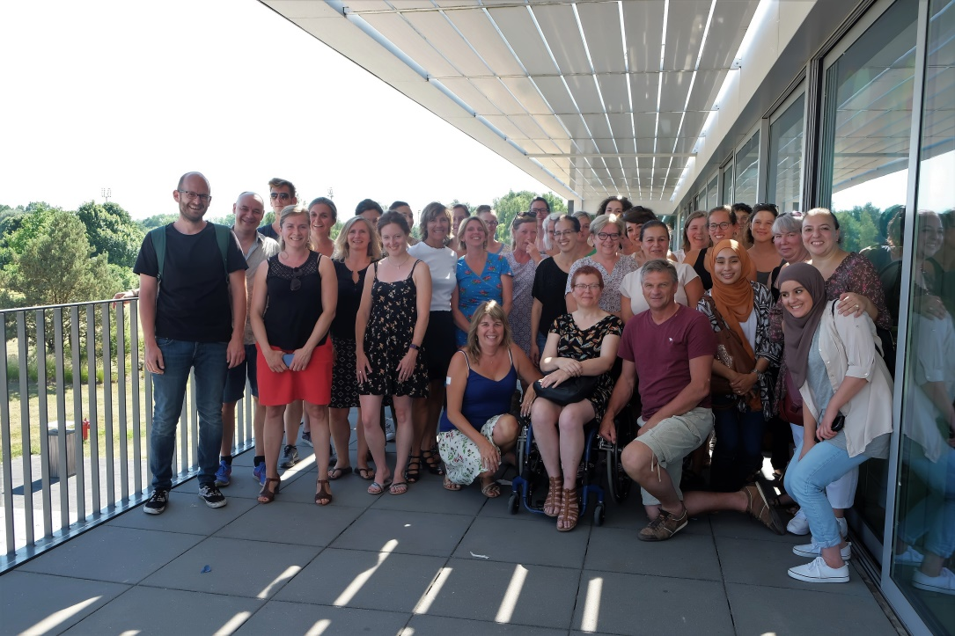

We - culture

Slide 31

Sharing Information

Slide 32

Law = foundation
Art.458: secrecy
Art.422bis: help people in need
Art.458bis: right of speech DV
Art.458ter: multidisciplinary consultation
Notes:
458 of the criminal code
Old article: dates time Napoleon

Slide 33

Shared Values
Work Together
Cliënt focused
Integrity
Safety first
Transparancy

Slide 34
Moral charter
Stop violence
Limit damage
Offer integral aid
Integrity
Safe environment for children
6. Dignified and meaningful life
7. Offender accountability, reïntegration en restoration
8. Positive relations
9. Protect employees
10. Indipendent moral judgement

Slide 35
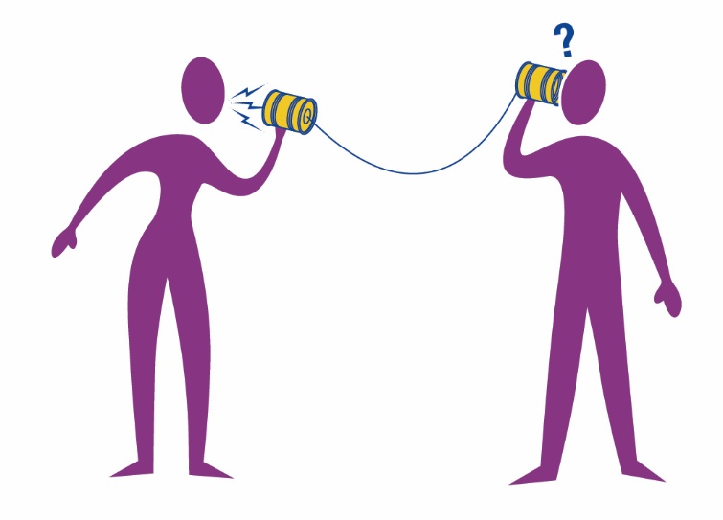
5. Communication
European Family Justice Center Alliance

Slide 36

Communication
Talk The Same Talk

Slide 37

6. Services
European Family Justice Center Alliance

Slide 38
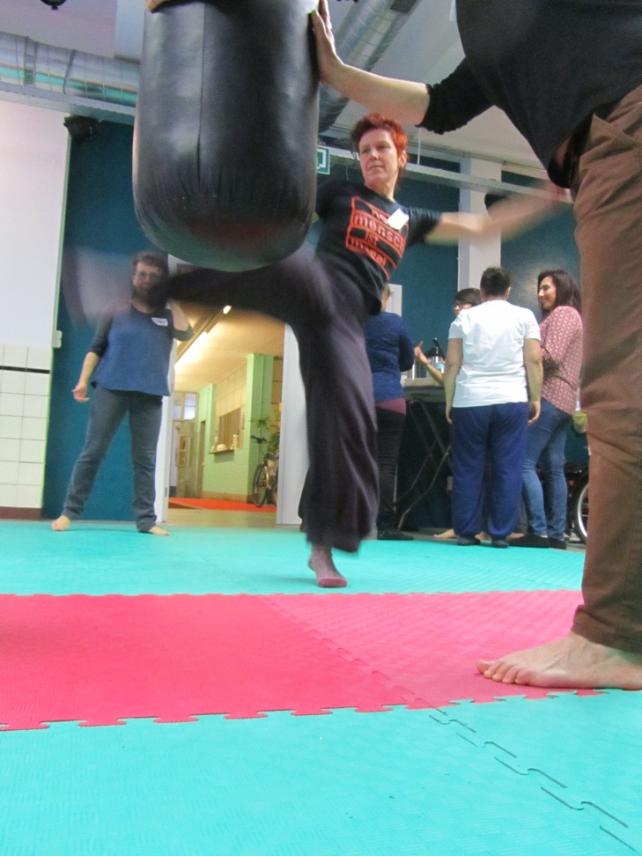
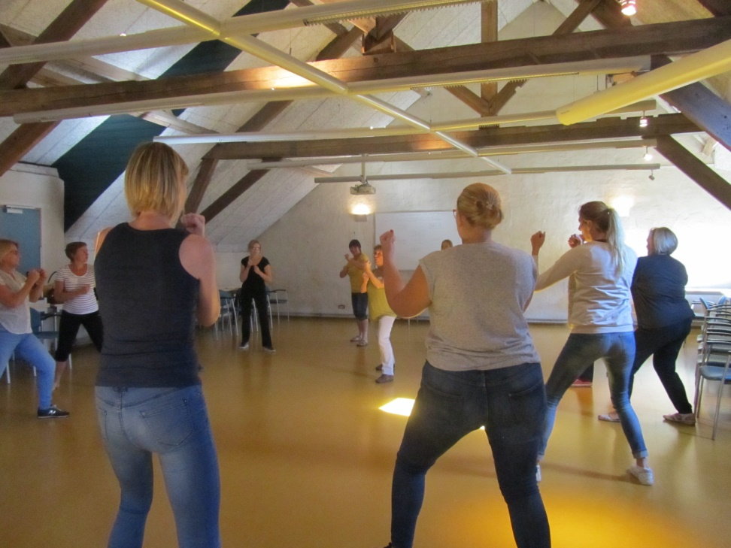
Empowerment – resilience training

Slide 39
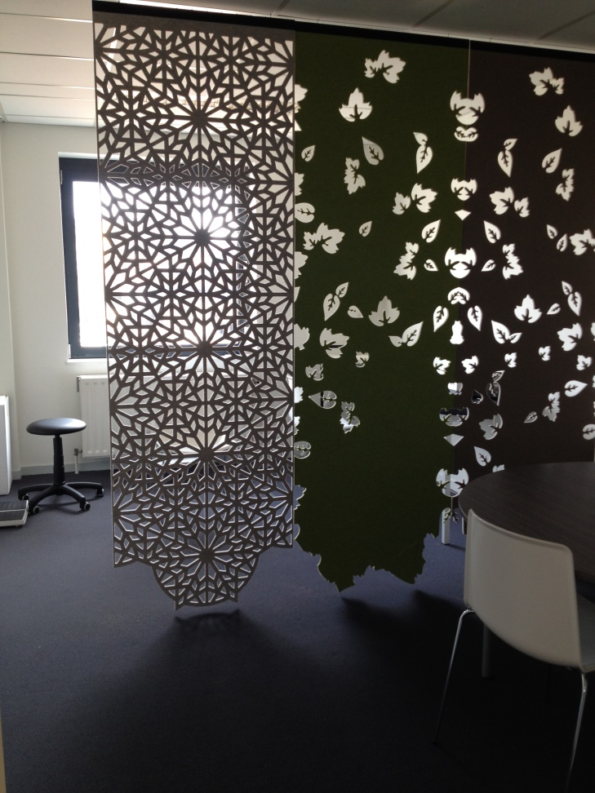
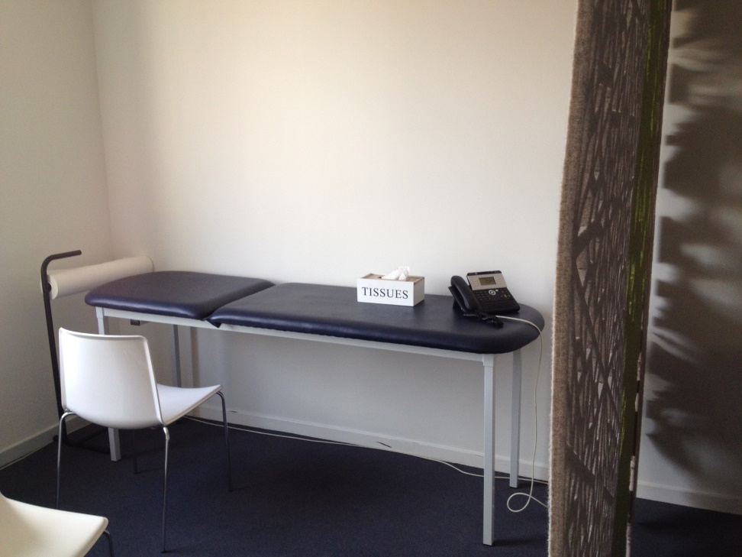
Medical Examination

Slide 40
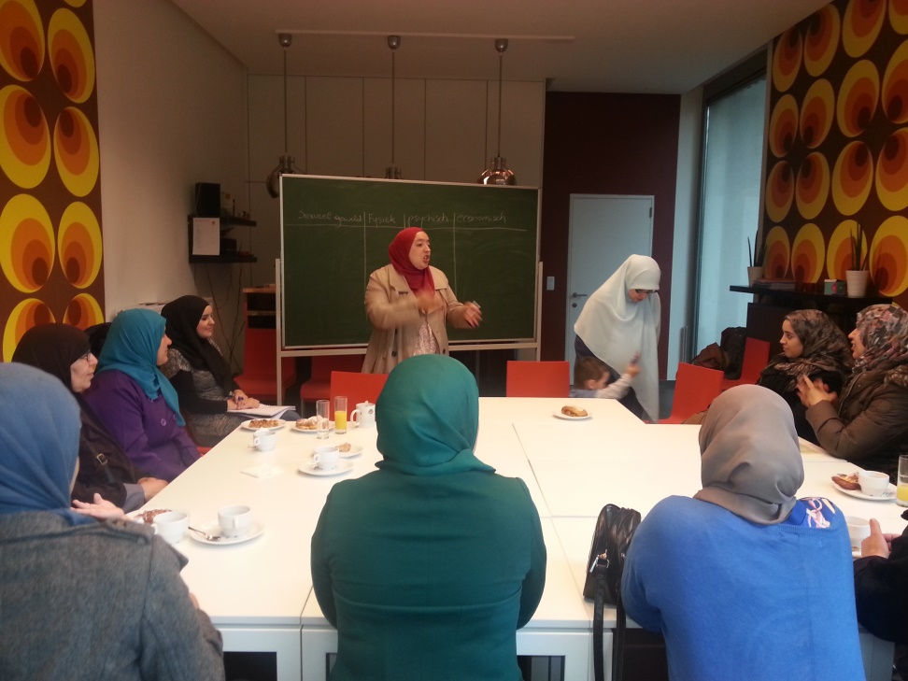
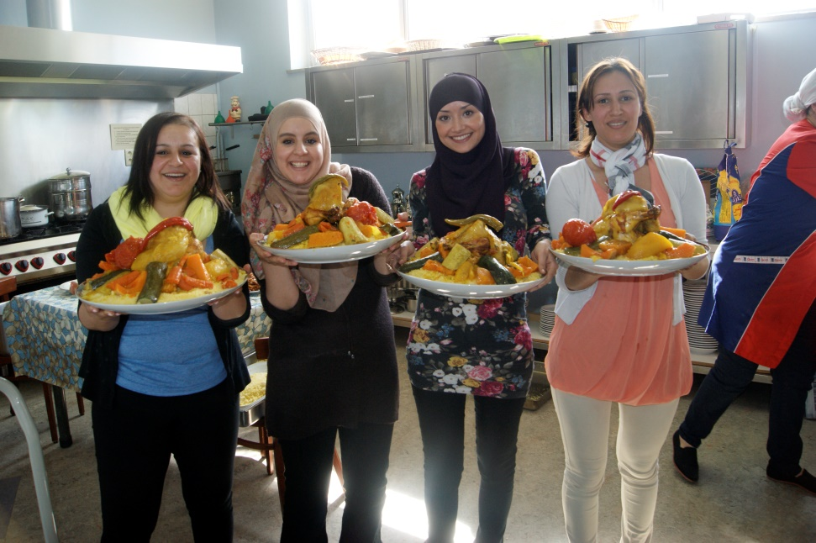
Selfhelpgroup

Slide 41
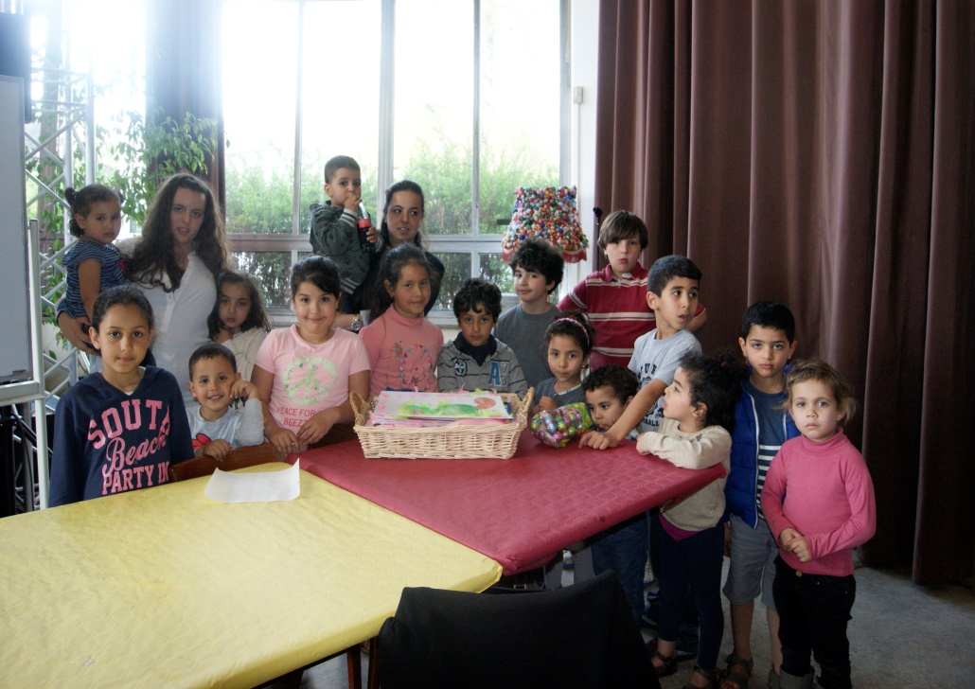
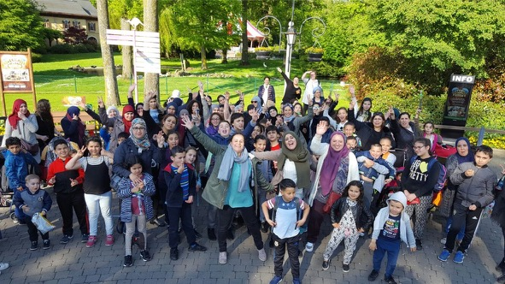
Hope for the Children

Slide 42
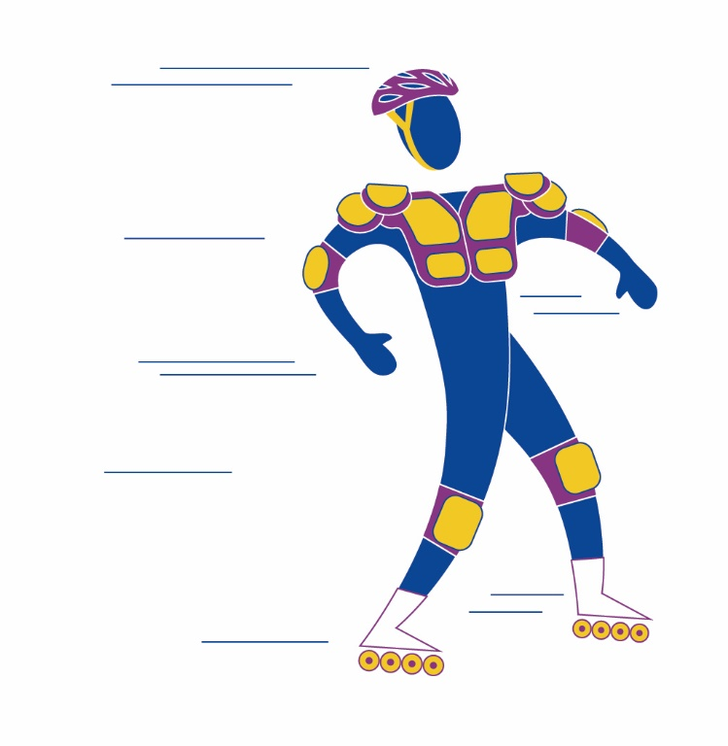
7. Safety
European Family Justice Center Alliance

Slide 43

Universal Human Right
Protected from Harm
Condition for aid, trauma processing and hope.
Hope > Well Being

Slide 44

Safety Planning
In the home
When leaving
In Public
Restraining Order
Children (custody)
Internet and media

Slide 45

8. Financing and Funding
European Family Justice Center Alliance

Slide 46
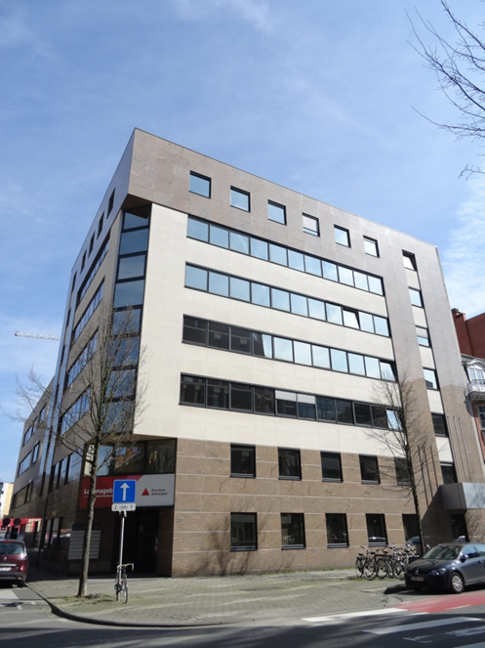
Governmentfunding
Infrastructure
  Location
  ICT
Staff
  Coördination
  Police & Justice
Projects

Slide 47
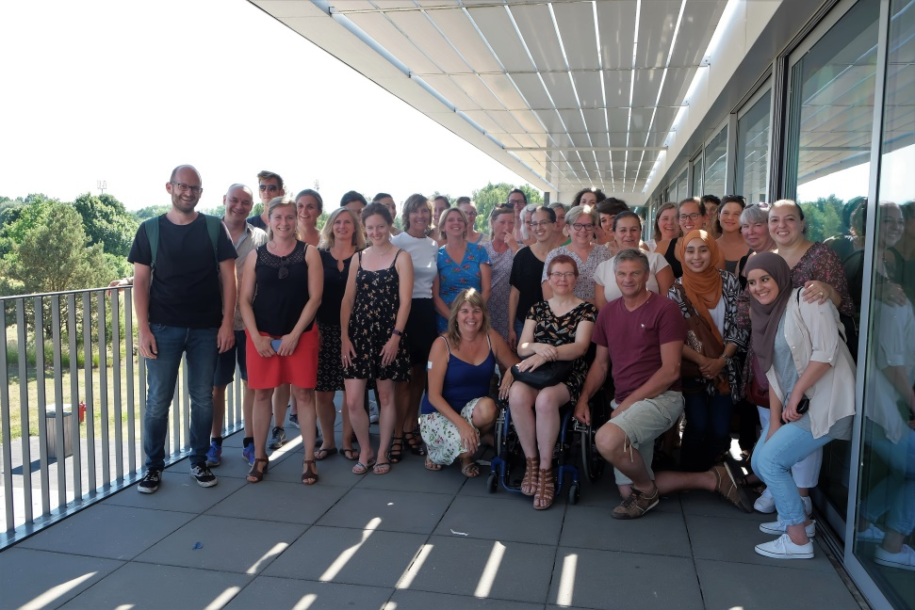
Private/non-profit
Staff
  Social workers
  Counsellors
  Therapists

Slide 48
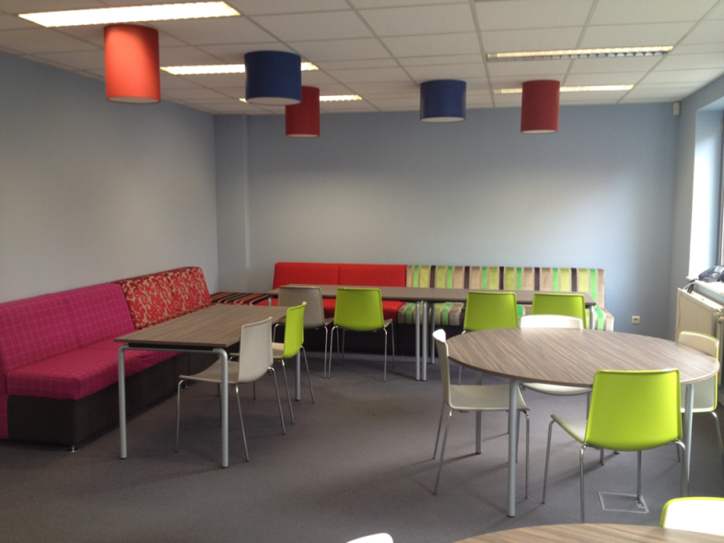
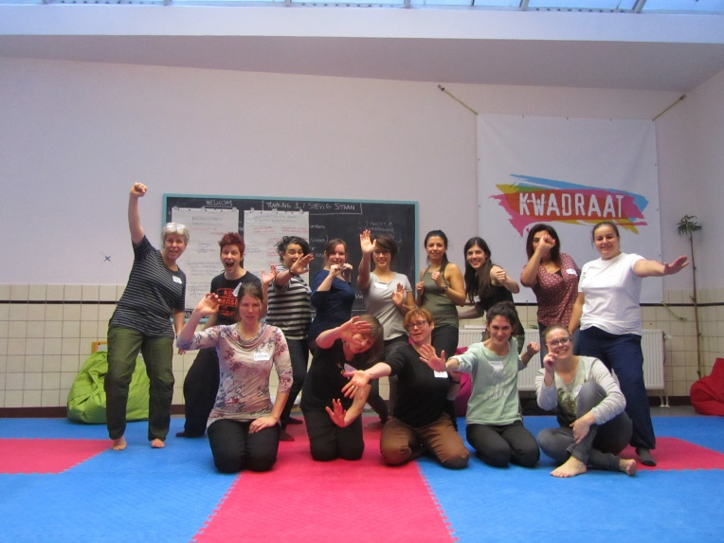
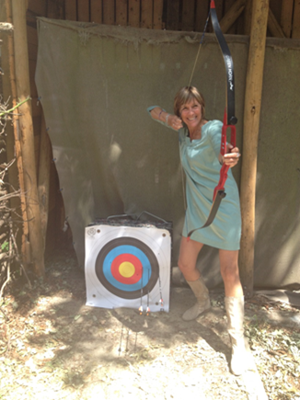
Private/Community
Corporate business
Services clubs
Sponsors
Decoration
Training

Slide 49

9. Be Creative
European Family Justice Center Alliance

Slide 50

Be Creative

Slide 51

10. Keep On Growing
European Family Justice Center Alliance

Slide 52
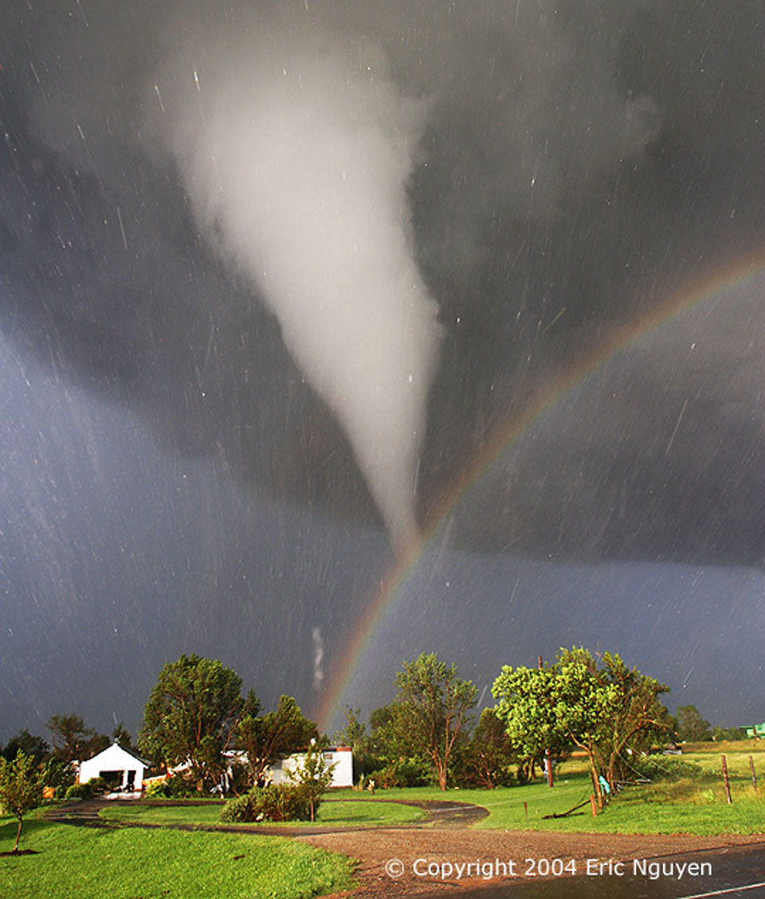
Change from outside
Social Dynamics
Elections
Reorganisations
Cutbacks
Investments

Slide 53

Change from inside
Sharing Information
Knowledge & expertise
New Insights
Downfalls
Successes

Slide 54
European Family Justice Center Alliance
www.efjca.eu

Slide 55


Thank you for your attention
European Family Justice Center Alliance
E-mail: info@efjca.eu
www.efjca.eu

