Slide 1
HOW TO START A FAMILY JUSTICE CENTER
One safe place for Hope and Empowerment
INTERNATIONAL CONFERENCE
Development and support of integrated multidisciplinary centers and chain approach to create pathways to hope for victims of domestic violence and child abuse

Slide 2



Benefits of an integrated Multidisciplinary approach of Domestic Violence in Europe
European Family Justice Center Alliance
Bert Groen, President of the European Family Justice Center Alliance
www.efjca.eu

Slide 3

WE HAVE A DREAM
European Family Justice Center Alliance
Eliminating domestic violence, sexual violence and child abuse and restoring hope and joy in the life of victims and their families!
www.efjca.eu

Slide 4

What is an integrated multidisciplinary approach?
European Family Justice Center Alliance
A coordinated community response in which social service agencies, health care providers and criminal justice providers join forces to work together to tackle domestic violence.
Ending domestic violence is everyone’s responsibility = Multi agency approach
www.efjca.eu

Slide 5
Do we make really a difference in the lives of victims?
European Family Justice Center Alliance
Multi agency approach of violence against women
has shown encouraging results, but there are
still major obstacles:
Victims are still expected to travel to a variety of organisations to get safety, help and support
Victims have to tell their story over and over again
www.efjca.eu

Slide 6
What are we doing wrong?
European Family Justice Center Alliance
Support is too much fragmented
Inadequate integrated and coherent approach
Lack of effective casemanagement
Too little attention for the children
Much relapse and repeated victimization and recidivism
www.efjca.eu

Slide 7
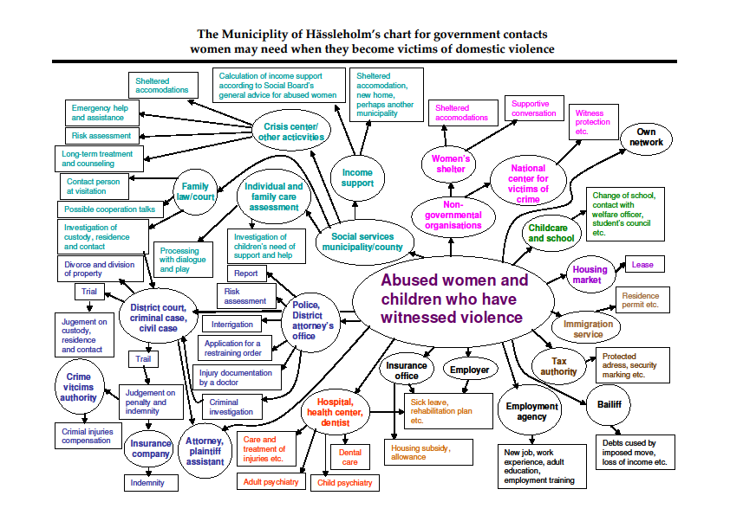
Complex systems victims cannot navigate are not the answer
European Family Justice Center Alliance
www.efjca.eu

Slide 8


What is a Family Justice Center?
European Family Justice Center Alliance
Co-location of a multidisciplinary team of professionals who are cooperating under one roof to offer help and support to victims of family violence and their children.
A place where professionals come together and survivors come first – A SAFE PLACE
All services survivors and their children need are under one roof.
www.efjca.eu

Slide 9
GUIDING PRINCIPLES (1)
European Family Justice Center Alliance
Safety comes first
Increase safety (direct and stable)
Victim-centered
Provide victim-centered services that promote victim autonomy and increases empowerment
www.efjca.eu

Slide 10
GUIDING PRINCIPLES (2)
European Family Justice Center Alliance
Survivor-driven
Shape services to clients by asking them what they need
Empowered
Offer survivors a place to belong even after crisis intervention services are no longer necessary
www.efjca.eu

Slide 11
GUIDING PRINCIPLES (3)
European Family Justice Center Alliance
Relationship-based
Maintain close working relationships among all collaborators/agencies
Offender-accountability
Increase offender accountability through evidence-based prosecution strategies and/or evidence based treatment programs.
www.efjca.eu

Slide 12
Main results and advantages FJC initiative
European Family Justice Center Alliance
Survivors don’t need to tell their story to many different persons and agencies
Safety for the survivors is increased
Improved access and confidence in the work of the Justice system
Professionals learn more about the possibilities of colleagues from other agencies
Reduce the number of domestic/family violence serious incidents and murders
Reduce child abuse incidents
Quicker response is possible when new incidents, threats or changing circumstances occur
Less recidivism!
www.efjca.eu

Slide 13

European Family Justice Center Alliance
Saving Lives – Reducing Costs
1 domestic violence murder will cost approximately £1.1 million
1 domestic violence murder prevented per year would provide savings equal to the total costs required to run the Family Justice Center for a year – including all key partner agency staffing costs
www.efjca.eu

Slide 14
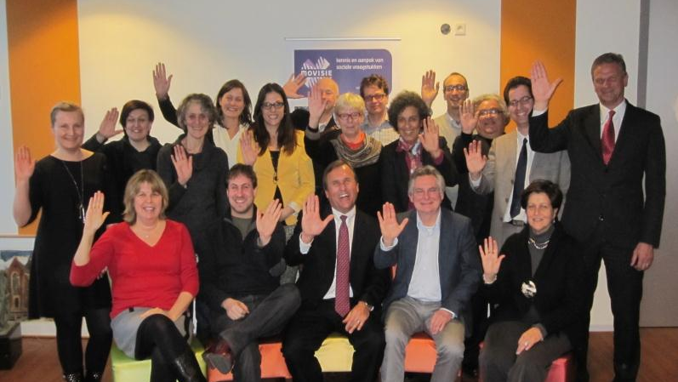
European Family Justice Center Alliance
www.efjca.eu

Slide 15
FJC’s in Europe
European Family Justice Center Alliance
The movie
www.efjca.eu

Slide 16
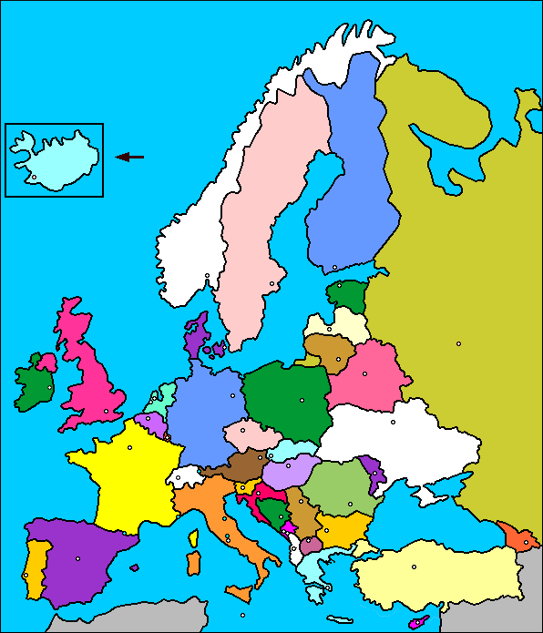
FJC’s in Europe: pilots & initiatives
European Family Justice Center Alliance
The Netherlands: Tilburg
Italy: Milan
Poland: Warsaw
Germany: Berlin
Belgium: Antwerpen/Hasselt/Mechelen/Turnhout
N. Ireland: Derry
Iceland: Reykjavik
Sweden: Malmö
France: Paris
www.efjca.eu

Slide 17

VISION of the EFJCA
European Family Justice Center Alliance
A future where all professionals work together to ensure safety and a better life for survivors of domestic violence, child abuse and domestic violence.
www.efjca.eu

Slide 18
What do we offer
European Family Justice Center Alliance
The central platform for FJC’s and related multidisciplinary models in Europe
Provide mutual support and cooperation among members
Creating and organizing a platform for conversation, consultation and exchange of ideas, expertise and good practices in the approach to domestic violence
Organizing a yearly conference
Supporting and following up new Family Justice Centers in Europe
www.efjca.eu

Slide 19
PRODUCTS
European Family Justice Center Alliance
Offering a ‘how to start a FJC’ package.
Book on how to start a FJC (One Safe Place)
Developing and providing trainings and instruments on a range of methodologies and products focusing on ACE, Trauma-informed care, Polyvictimization and Hope.
Offering regular webinars on topics of interest for the FJC’s and Multi Agency models.
www.efjca.eu

Slide 20
THE FJC AFFILIATION PROCES
European Family Justice Center Alliance
The EFJCA offers two levels of affiliation, each designed to reflect the individual needs of local communities, while ensuring adherence to best practices and trauma-informed approaches in service provision.
The levels of affiliation include:
Affiliated Multi-Agency Models
Affiliated Family Justice Centers.
www.efjca.eu
Notes:
These standards ensure communities are creating systems change and challenging the traditional way of providing services to victims and their families by bundling services and integrating critical service providers from the advocacy and criminal justice systems

Slide 21

2018 and Beyond: most important topics
European Family Justice Center Alliance
Support existing and new members
Support and outreach to candidate-members
Work with health sector
Strangulation + Conference 2018
Polyvictimisation and trauma-informed care
Applying for grants
Work with other EU networks
www.efjca.eu

Slide 22
AFFILIATED MULTI-AGENCY MODELS
European Family Justice Center Alliance
Have at least three different co-located service providers
Adhere to and demonstrate the implementation of Family Justice Center Guiding Principles in service delivery
Engage meaningfully with the European Family Justice Center Alliance’s team
Provide requested statistics and data to the EFJCA.
www.efjca.eu

Slide 23
AFFILIATED FAMILY JUSTICE CENTER MODELS
European Family Justice Center Alliance
Have a centralized intake process and an information sharing process with a minimum of the following, full time, co-located agencies:
    A community based organisation
    Law enforcement
    Prosecutors unit
    Civil legal services.
Adhere to and demonstrate the implementation of Family Justice Center Guiding Principles in service delivery
Engage meaningfully with the European Family Justice Center Alliance’s team
Provide requested statistics and data to the EFJCA.
www.efjca.eu

Slide 24
Thank you for your attention
European Family Justice Center Alliance
E-mail: info@efjca.eu
www.efjca.eu

Slide 25
European Family Justice Center Alliance
www.efjca.eu

Slide 26
The multidisciplinary approach and the FJC model from the perspective of the victim - Hihglights
European Family Justice Center Alliance
Presentation of 2 different FJC models in Europe:
From the perspective of the victim
From the perspective of the family orientated approach (Tilburg)
Statements:
When children are involved, their safety must be the priority
A perpetrator program is in the best interest for victims.
Discussion about initimate terrorists & can a program influence the behavior of a perpetrator & are perpetrators always involved in the services provided by the FJC.
www.efjca.eu

Slide 27
European Family Justice Center Alliance
www.efjca.eu

Slide 28
European Family Justice Center Alliance
www.efjca.eu

Slide 29
HOW TO START A FAMILY JUSTICE CENTER
One safe place for Hope and Empowerment
INTERNATIONAL CONFERENCE
Development and support of integrated multidisciplinary centers and chain approach to create pathways to hope for victims of domestic violence and child abuse

Slide 30
REMEMBER OUR DREAM
European Family Justice Center Alliance
Eliminating domestic violence, sexual violence and child abuse and restoring hope and joy in the life of victims and their families!
LET US MAKE THIS DREAM COME TRUE
WE CAN MAKE A DIFFERENCE IN THE LIVES OF VICTIMS AND THEIR CHILDREN!
www.efjca.eu

Slide 31
European Family Justice Center Alliance
www.efjca.eu

Slide 32
European Family Justice Center Alliance
www.efjca.eu

Slide 33
European Family Justice Center Alliance
www.efjca.eu

