Slide 1
Bjarkarhlíð
Berglind Eyjólfsdóttir
Brussel 1. December 2017

Slide 2
The beginning
Domestic violence case
Lack of support
Domestic violence was not considered sufficiently serious by the system – “private matter”
Inconsistency in handling cases and registration
Repitition common - the cycle of violence continued
Domestic violence cases one of the most difficult part of officers job
Few cases through the system
Not using the methods we had
The system was not working sufficiently for those involve

Slide 3
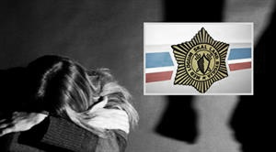
“Keeping the window open” “Together against violence”
Prevent repeated violations
Prosecution
Assistance to victims and perpetrators
To target the first response of the Police and improve investigations
Option of restraining order and the perpetrators expulsion of home (Austrian way)
Childrens safety

Slide 4
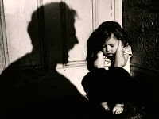
”Keeping the window open” ”Together against violence”
Scene investigation
Recording of testimony
Medical examination
Social services referred
Provision of restraining order and expulsion of home
Provision of support
Follow-up visit to the home within a week of event
Risk assessment/
Emergency button

Slide 5
Circle of violence
tension
chaos
regret
„normal“

Slide 6
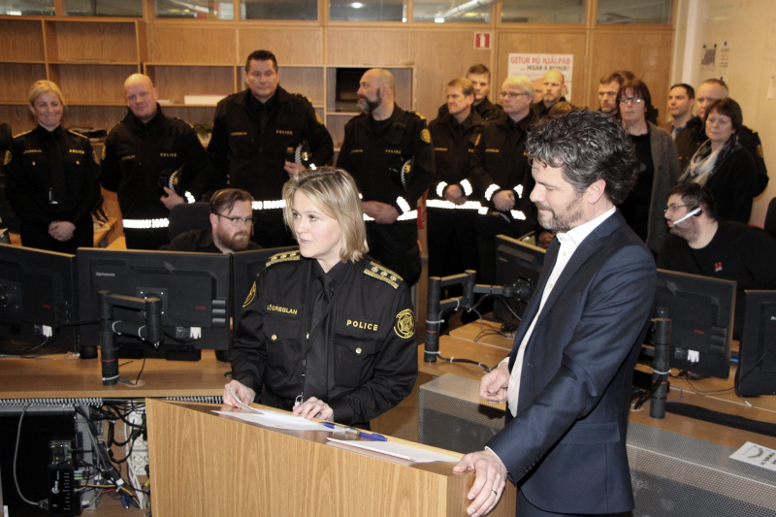
The importance of social workers
Police
Child protection
Social service
Support for victims and children locally
Witness in the case
Maybe there is more information
Greater potential for cooperation with victims
Take the victim to a doctor and get help
Get the perpetrator to seek help

Slide 7
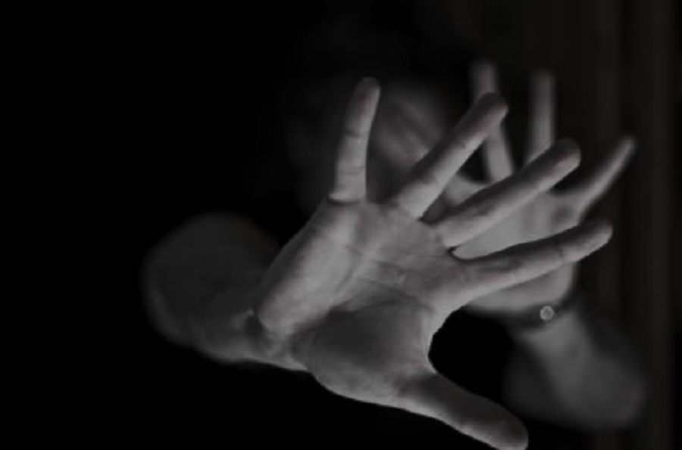
Manslaughter
Since 2003 there have been 25 cases of manslaughter in Iceland
50% or 12 cases fall under the definition of domestic violence
and one case is defined as stalking
9 cases are the result of violence in close relationships
one case is defined

Slide 8
The silo effects

Slide 9
What did we need to start?
Role model - Family justice centre
Tailored to Icelandic system
Minimum funding
Qualified staff
Focus on the individuals who seek assistance

Slide 10
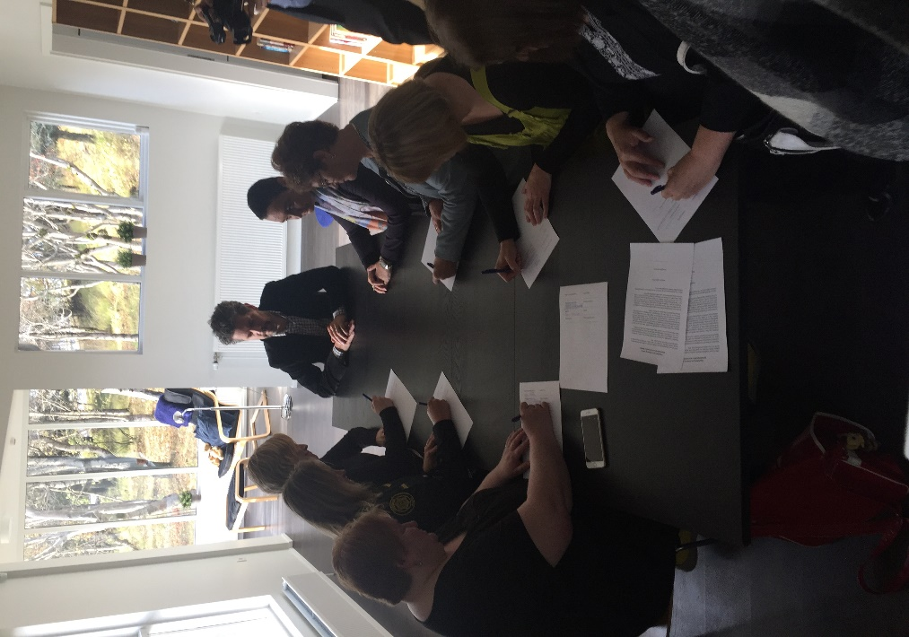
Bjarkarhlíð
Person in Bjarkarhlíð
Social service
Children's protecion
NGO´s
Police
Others

Slide 11
Challenges
Person
System
NGO´s
Legal frame – regulations – procedures
Social service
Children's safety
Consent
“System thinking”
Knowledge

Slide 12
Highlights - key elements
Collect data
Silo effects off
Cooperation
Use all possible measures
Sustainable funding
Support – service – assistance
Outreach
NO Brainer!!!

Slide 13
What is Bjarkarhlíð?

Slide 14
Bjarkarhlíð
The center was formally opened the 2. mars 2017
The Family Justice Center model comes from the USA
Iceland is the 8th country in Europe
Pilot project for 2 years
Interdisciplinary cooperation
All services in Bjarkarhlíð are free of charge
One stop shop

Slide 15
Partnering with Bjarkarhlíð
City of Reykjavík
Ministry of Welfare
Ministry of Justice
Metropolitan Area Police
Stígamót
Drekaslóð
Womens Shelter
Icelandic Human Rigths Center
Women‘s counseling

Slide 16
What do we do?

Slide 17
Assistance for individuals, 18 years and older, and of all sexes that are survivors of violence.
Individuals that have suffered from domestic violence, sexual violence, violence against the elderly, or human trafficking, can get comprehensive services that focus on their needs.
Coordinated services and professional consultation and counselling.
Individual interviews for survivors of violence.
Legal consultation.
Consultation with social workers and help with the process of applying for other resources, such as financial support and housing benefits.
The police provides information about the justice system and charge process.
Assistance from the police in assuring safety for survivors and risk assessment.
Education and courses about the nature and consequences of violence.

Slide 18
How we do it!
Coordination of multiple local providers from 6 sites to establish support and justice services in one physical location.
Providing „one stop shopping“ for victimes in need of services.
The first client interview is with a social worker.
Assessmennt of the need for service.
Matching the client need to the support that is offered.

Slide 19
Bjarkarhlíð is for everyone

Slide 20
What is in your experience the most important benefit of the FJC? What was most helpful for you?
The most helpful thing, in my case, was calling the FJC on a friday afternoon and making an appointment the following Monday. When I got there, I felt no pressure at all. I took all the time I needed to talk about my situation and after having talked to the social worker and telling her that I was going to leave my partner, I was able to talk to the police in order to press charges against him.
Being able to get all the help needed at the same location is very helpful. Instead of having to make appointments with many different people all over town.

Slide 21
The importance of FJC
To find that there are people who are there for you and are
willing to help you.
What do you need from the FJC?
Psychological support and guidance.
Guidance for everyone working within the FJC?
Make sure that everyone is treated with kindness and respect.

Slide 22
Bjarkarhlíð is a Family Justice Center for violence survivors.
Our goal is to offer support and consultation about the nature and consequences of violence, in addition to a clear message that violence is not tolerated.
Bjarkarhlíð offers lectures and courses about the different manifestations of violence and the effects they have on survivors.

Slide 23
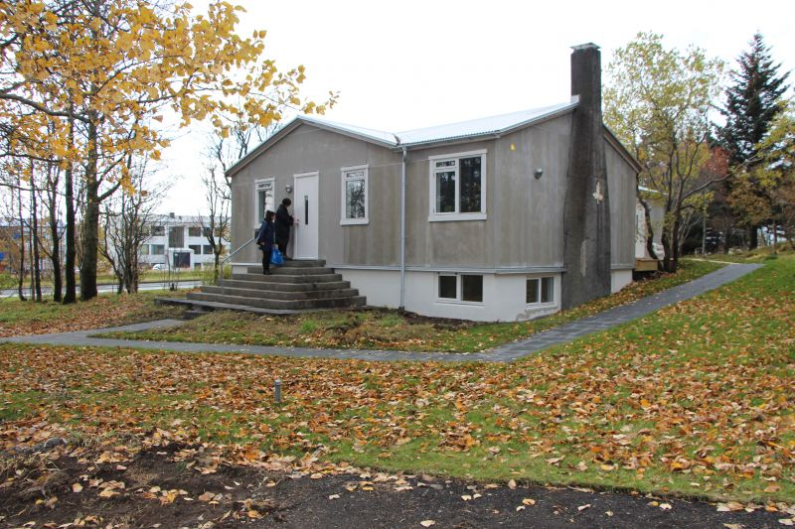
Bjarkarhlíð

Slide 24
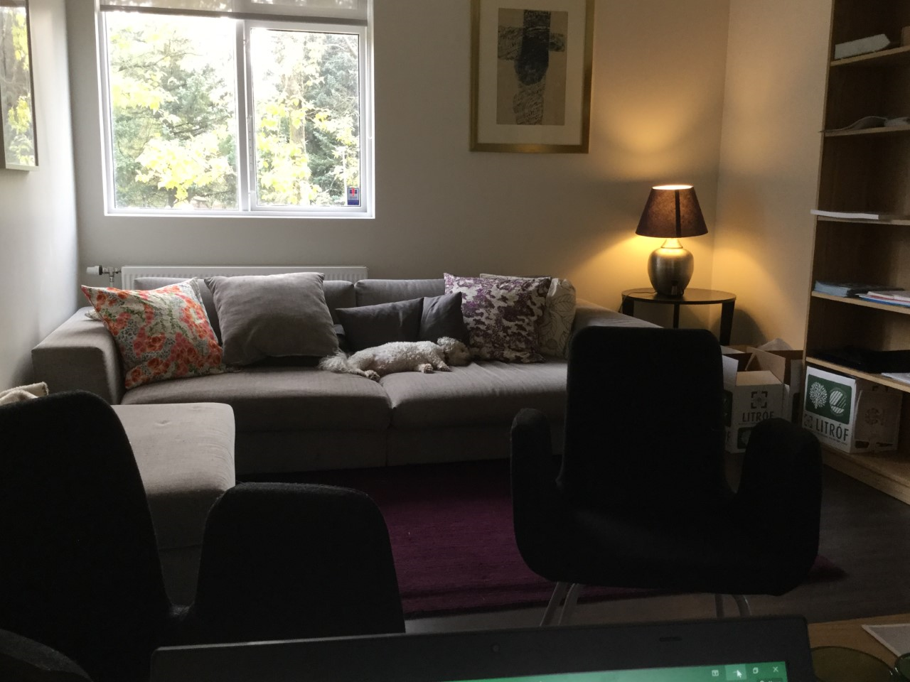
Police Officers office at Bjarkarhlíð

Slide 25
Never doubt that a small group of thoughtful, committed citizens can change the world. Indeed, it is the only thing that ever has. ~ Margaret Mead, Anthropologist Thank you!

