Slide 1

Multidisciplinary approach in child protection – experiences of Child and Youth Protection Center of Zagreb
Brussels
December 1, 2017
Child and Youth Protection Center of Zagreb, Croatia
Ana Marija Spanic, psychologist

Slide 2
Presentation overview
Founding of the Center
Basic principles of work
Model of work
assessment and treatment
publishing
research
education
forensic activities
multidisciplinary approach
• interagency collaboration
• child friendly approach and environment

Slide 3

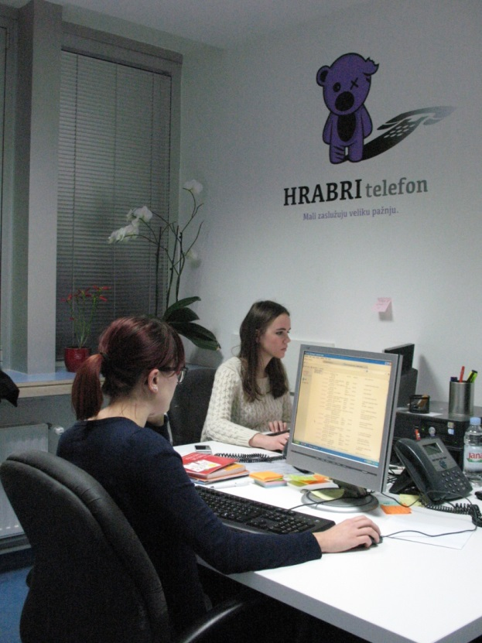
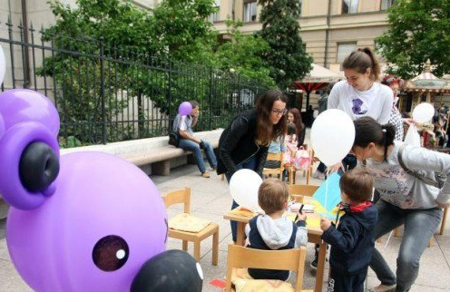
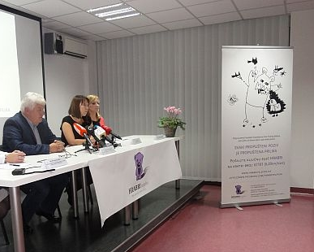
NGO Brave Phone
helpline for abused and neglected children
public actions, brochures and leaflets for parents and professionals, co-operation with the media

Slide 4
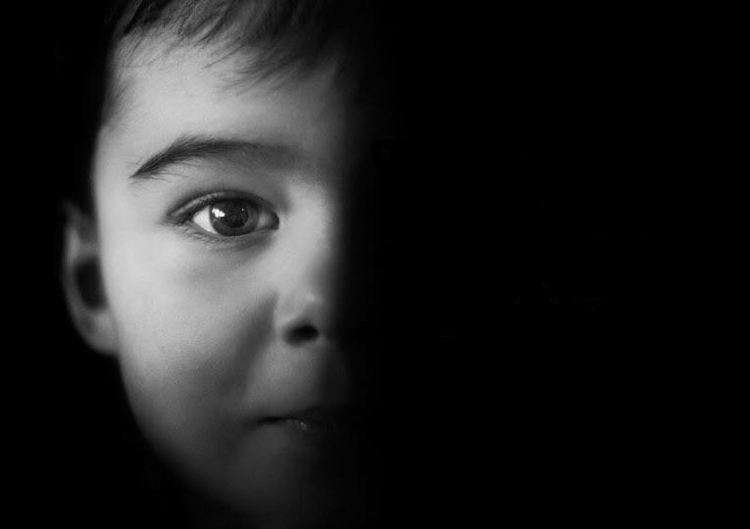
CHILDREN HAVE SPOKEN OUT
• insufficient number of mental health profesionals in general
• insufficient number of profesionals trained in working with sexually abused children
• inefficient interagency collaboration
• lack of understanding of the role of other professionals involved in the process
child abuse and neglect prevalence research

Slide 5
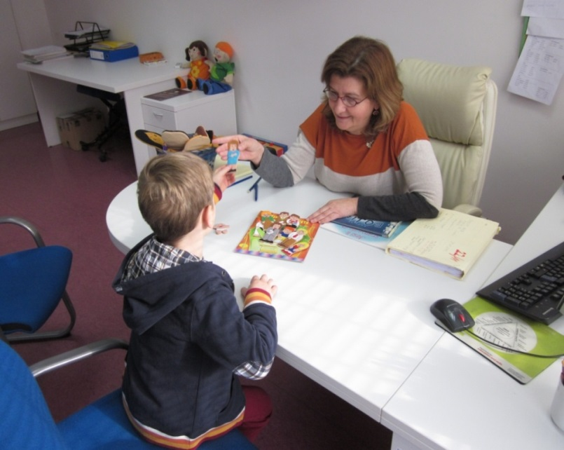
Child Protection Center of Zagreb
The key purpose of the work of the Center is providing help and support to children who have experienced various traumatic events, as well as children at risk of abuse, and their families.
opened by the end of 2002 as a permanent solution within the health care system

Slide 6
1200 to 1500
new patients
per year
300 to 500
patients in continued treatment
From 2003 by the end of 2016, 15 208 children were assessed

Slide 7
COMMON REASONS FOR REFERRAL
suspected abuse and/or neglect
high conflict divorce
witnessing domestic violence
traumatic event
problematic sexual behavior
complicated grieving
behavioral difficulties
ADHD
learning disabilities
bullying
developmental disabilities
ABUSED AND/OR NEGLECTED CHILDREN
CHILDREN AT RISK FOR ABUSE
CHILDREN AT RISK FOR PERPETRATING VIOLENCE

Slide 8
MODEL OF WORK
Multi-disciplinary approach
Interagency collaboration
BEST INTEREST OF THE CHILD
Child friendly environment and approach

Slide 9
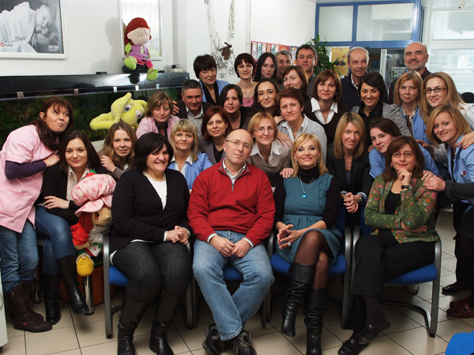
Our team
12 psychologists
4 psychiatrists
neuropaediatrician
2 social workers
2 social pedagogues
speech therapist
6 nurses
jurist

Slide 10
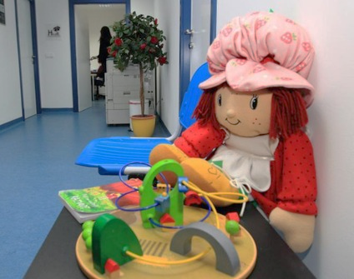
Child friendly environment
accessible and physically safe for children of all ages and developmental stages, including children with disabilities and/or special needs
child friendly surroundings and materials
no contact between victim and alleged offender – separate entrance

Slide 11

PROCEDURES AND PROTOCOLS
Referral
Initial interview
Treatment
Sharing assessment findings
Follow-up
Multidisciplinary assessment

Slide 12
REFERRALS
 | % in 2016
school | 12,9
day care center | 2,7
social services | 30,7
physician | 8,8
police | 2,0
residential care facilities | 0,8
parents | 37,8
other | 4,3

Slide 13
Cross-institutional cooperation
CHILD PROTECTION CENTER
SCHOOLS
KINDERGARTENS
PARENTS
CITIZENS
NGOs
POLICE
STATE ATTORNEYS
COURT
CHILD WELFARE CENTERS
HEALTH INSTITUTIONS

Slide 14


“Working with a single sexually abused child
requires at least four telephone calls”
William N. Friedrich, PhD
Mayo Clinic
Daily team meetings
exchanging information – no need for repeated questioning
case management – joint decisions regarding assessment and treatment

Slide 15


Challenges
FORMALLY
IN PRACTICE
health care institution
providing services for:
  social services
  law enforcement
  prosecution
  judicial system
  educational institutions
Many services not recognized (and therefore, not funded) by the health care system!
Part of solution: two sources of budgeting

Slide 16

TREATMENT
The multidisciplinary team develops a treatment plan according to the individual needs of the child.

Slide 17
Modalities of supporting the child/family
Support and access to information
Treatment
counseling
Crisis support interventions
psychotherapy
speech-language therapy
pharmachotherapy

Slide 18
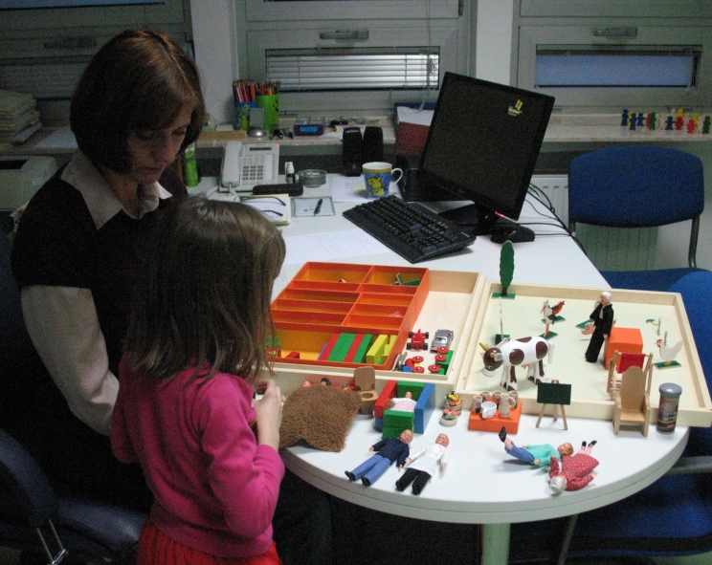
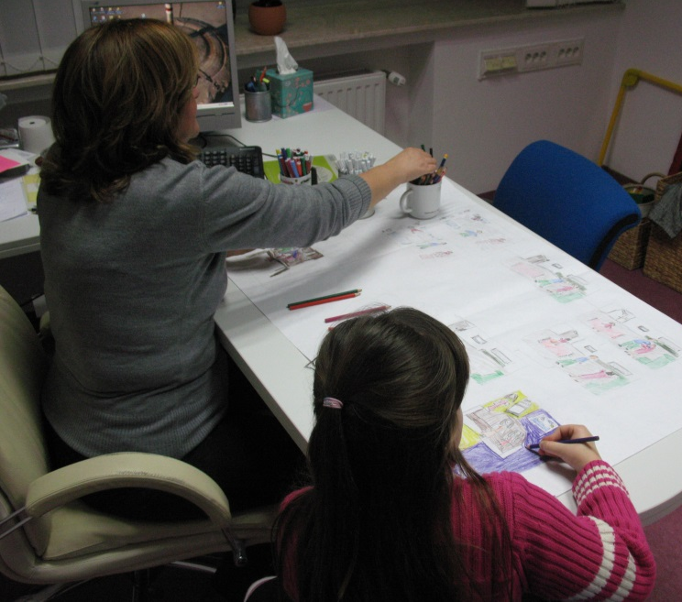
Psychotherapy
trauma focused cognitive-behavioral therapy
play therapy
cognitive-behavioral therapy
gestalt therapy
psychoanalysis
transactional analysis
systemic therapy
integrative therapy

Slide 19
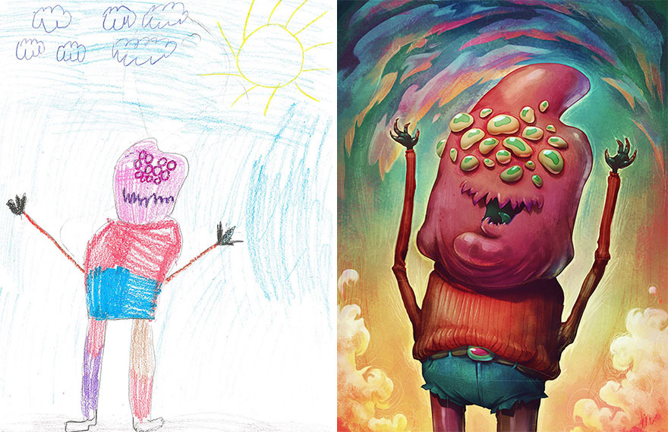
Forensically sensitive therapy
court proceedings are unfinished, but the child needs immediate treatment
projective techniques and interpretations of child’s play and drawings are avoided

Slide 20
„I want to withdraw my statement because of my mom, they love each other so I don't want him to go to jail. She called me a hundred of times, asking me not to take her husband away from her.
Now mom will be happy, and I will be happier for her. It's my fault that he behaves badly towards her.
All of it happened, but my mom never believed me, nor did my teacher, or anyone else I told. Often I can't sleep at night because my mom doesn't trust me. I feel like I don't have anyone. I want my mom to be happy, then she will love me.”
Notes:
From non-abusive to supportive parent

Slide 21

Non-abusive parent → supportive parent
Support from a non-abusive parent is one of the most important predictors of child’s adjustment
(Cohen i Mannarino, 2008)
more important than characteristics of the abuse itself
more important than the form of treatment

Slide 22
Forensic activities
Forensic interviews within multidisciplinary assessments
Conducting forensic evaluations at the order of the court:
  credibility assessments of children victims and witnesses of violence
  child custody evaluations
  forensic evaluations of juvenile offenders
Interviewing children on the center`s premises within court proceedings → significant challenges

Slide 23
„I was raped when I was 13, now I am 15. First I was at Children's Hospital where I was examined and questioned by a gynecologist and a psychiatrist. Later I went to the Child Protection Center where I spoke to a psychiatrist, a psychologist and a social worker. Then I had to go to the Police where I was interrogated 4 times. I also had to talk twice about what happened to Social Services. At the Court I was questioned once via video link. I also had to undergo a forensic evaluation and I spoke again to a psychiatrist and a psychologist.
Altogether, I had to talk about
what happened to me 11 times.
It felt terrible to talk about it
so many times,
as if I was to blame.“
Notes:
Upozoriti da broj ne odgovara gornjem zbroju
23

Slide 24
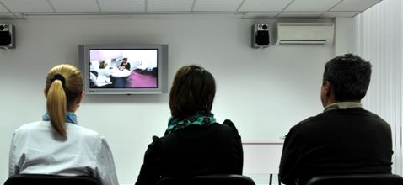
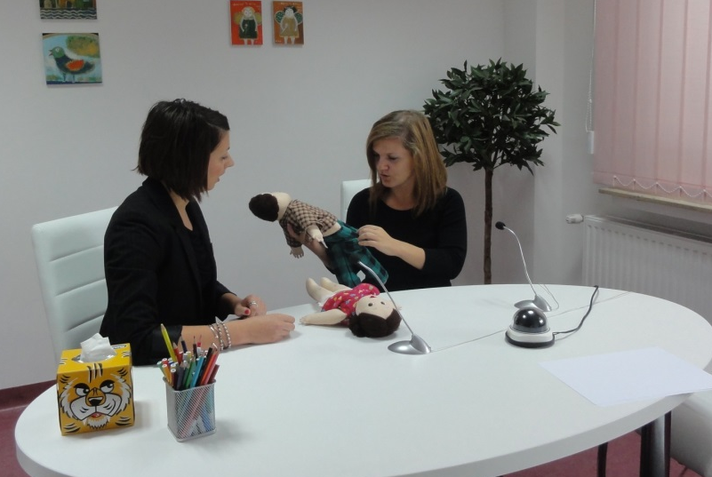
Cooperation with the court of law
WE ENCOURAGE JUDGES TO INTERVIEW CHILDREN
ON THE CENTER'S PREMISES
One room – Center´s interviewer and the child
Another room –judge, SA, defendant (separate exit), defense lawyer, social worker, police…

Slide 25
Publishing
distributed free of charge (funded by City of Zagreb)
16 publications, 400 000 copies
also available online
prevention and intervention

Slide 26
Reaching a large number of children and parents nationwide in collaboration with Brave Phone
2004, 2008
internet use, cyberbullying and exposure of children to online sexual content (N=4000; N=2700)
2006
2008/2009
2003
bullying (N=5000)
prevalence of child abuse and other traumatic experiences in childhood (N=4191)
knowledge and attitude of pediatricians and family doctors (N=590) and doctors of dental medicine (N=350) related to child abuse and neglect
2015
experiences and behaviors of children on social networks – cyberbullying and problematic Internet use (N=1489)
2017
electronic media use (screen time) in preschool children
Notes:
Research topics:
prevalence of child abuse and other traumatic experiences in childhood (N=4191) 2006
bullying (N=?)2003
2008 - internet use, cyberbullying and exposure of children to online sexual content (2004 – 4000; 2008. N=2700)
2015 - experiences and behaviors of children on social networks (N=1489)
knowledge and attitude of medical doctors related to child abuse and neglect (N=590) 2008

Slide 27

1. Organizing trainings lead by respected international experts for our staff
  Linda C. Steel and S. Sayle National Children's Advocacy Center, Alabama
  William N. Friedrich Mayo Clinic, Minnesota
  J. Wilson University of Ohio
  Barbara Bonner National Center on the Sexual Behavior of Youth, Oklahoma
  Nick and Karen Woodall, Family Separation Clinic, UK
  2. Ongoing trainings by the staff for the staff
3. Encouraging participation in trainings, conferences as well as postgraduate studies by providing financial support
Notes:
Forenzična evaluacija – trodnevni seminar L. Cordisco Steel i S. Sayle, Nacionalni centar za zastupanje djece u Alabami, SAD
Edukacija dr. W.Friedricha (Mayo klinika, SAD): Rad s traumatiziranom djecom i obiteljima
Predavanje dr. J. Wilsona: Trauma i empatija
Edukacija dr.Barbare Bonner: Treatment of maltreated children ; TF-CBT (National Center on the Sexual Behavior of Youth)

Slide 28

Supervision
High risk of vicarious traumatization
and burnout
mandatory participation
organized and funded by the Center (twice per month)
external supervisor

Slide 29

Education of students and professionals
Educational center for students of:
  psychology
  social work
  education and rehabilitation sciences
  teachers education
  police academy
  law
Trainings in cooperation with department ministries and Government for professionals from:
    Social services
    Healthcare system
    Educational system
    Law enforcement
    Judicial system
    NGO`s
Regional and international trainings
Study visits (domestic and international)

Slide 30
  Model of good practice
ISPCAN MULTI-DISCIPLINARY TEAM AWARD 2008
The International Society for Prevention of Child Abuse and Neglect
ISPCAN

Slide 31
Thank you for your attention
www.poliklinika-djeca.hr/english/
anamarija.spanic@poliklinika-djeca.hr

