Slide 1
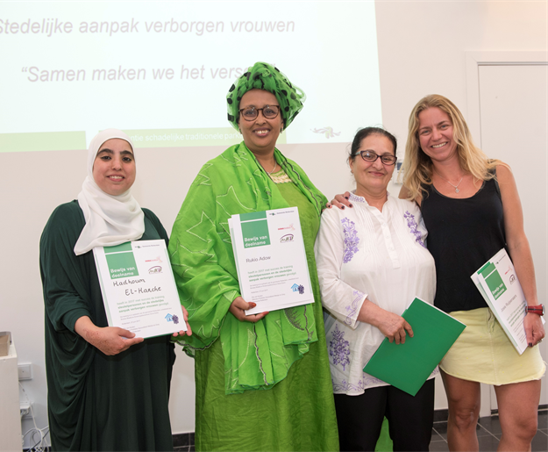
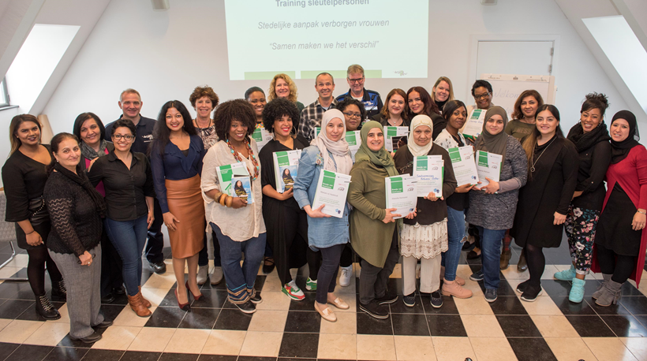
Voices: the stories of survivors of intimate terror
Shantie Jagmohansingh
Senior policy advisor – city of Rotterdam & Author

Slide 2
Fayza Oum’HamedOum Hamed

Slide 3
Eyes and ears in the city

Slide 4
DE KIER

Slide 5
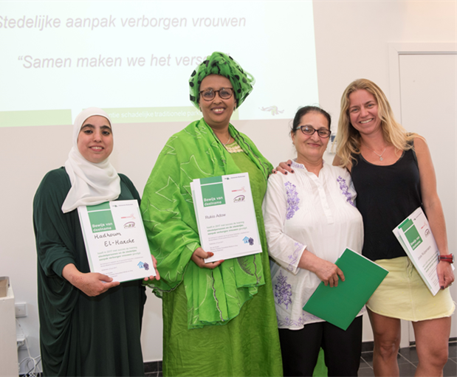
Survivors and pioneers

